Slide 1
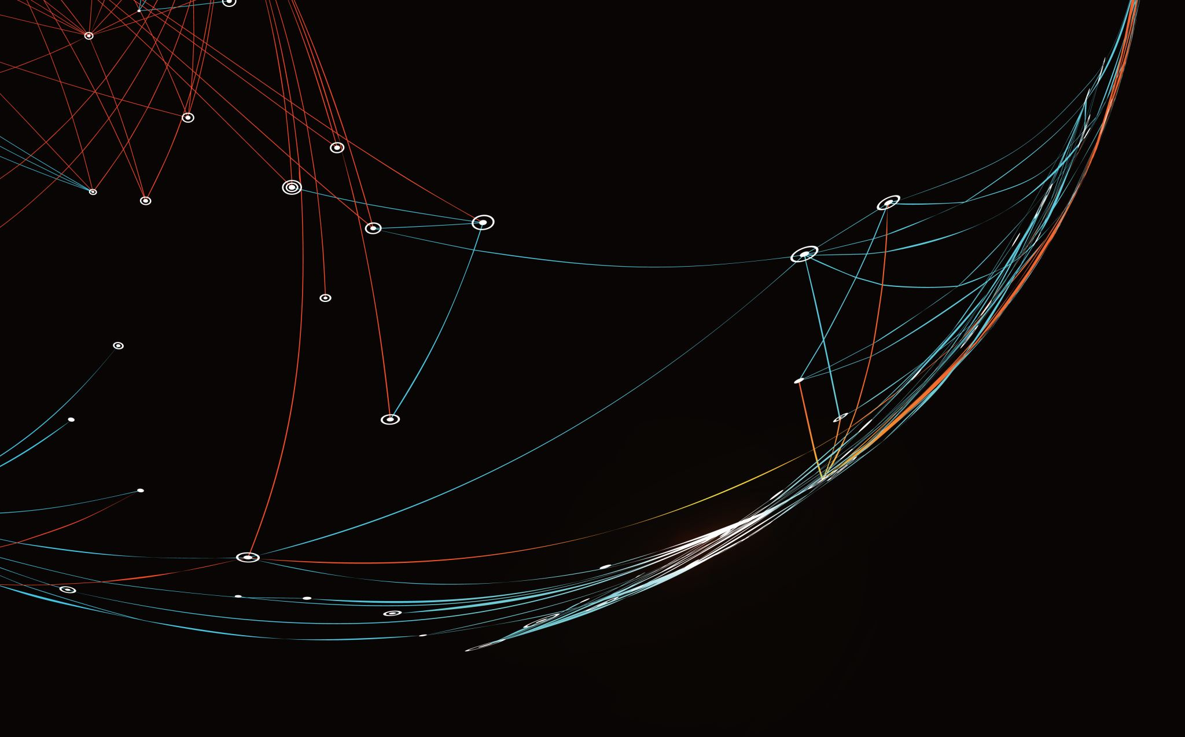
Meeting 6.3.20
Lena & Lishi

Slide 2
Motivating Question
How does the mode of disassembly help actin control its size?

Slide 3
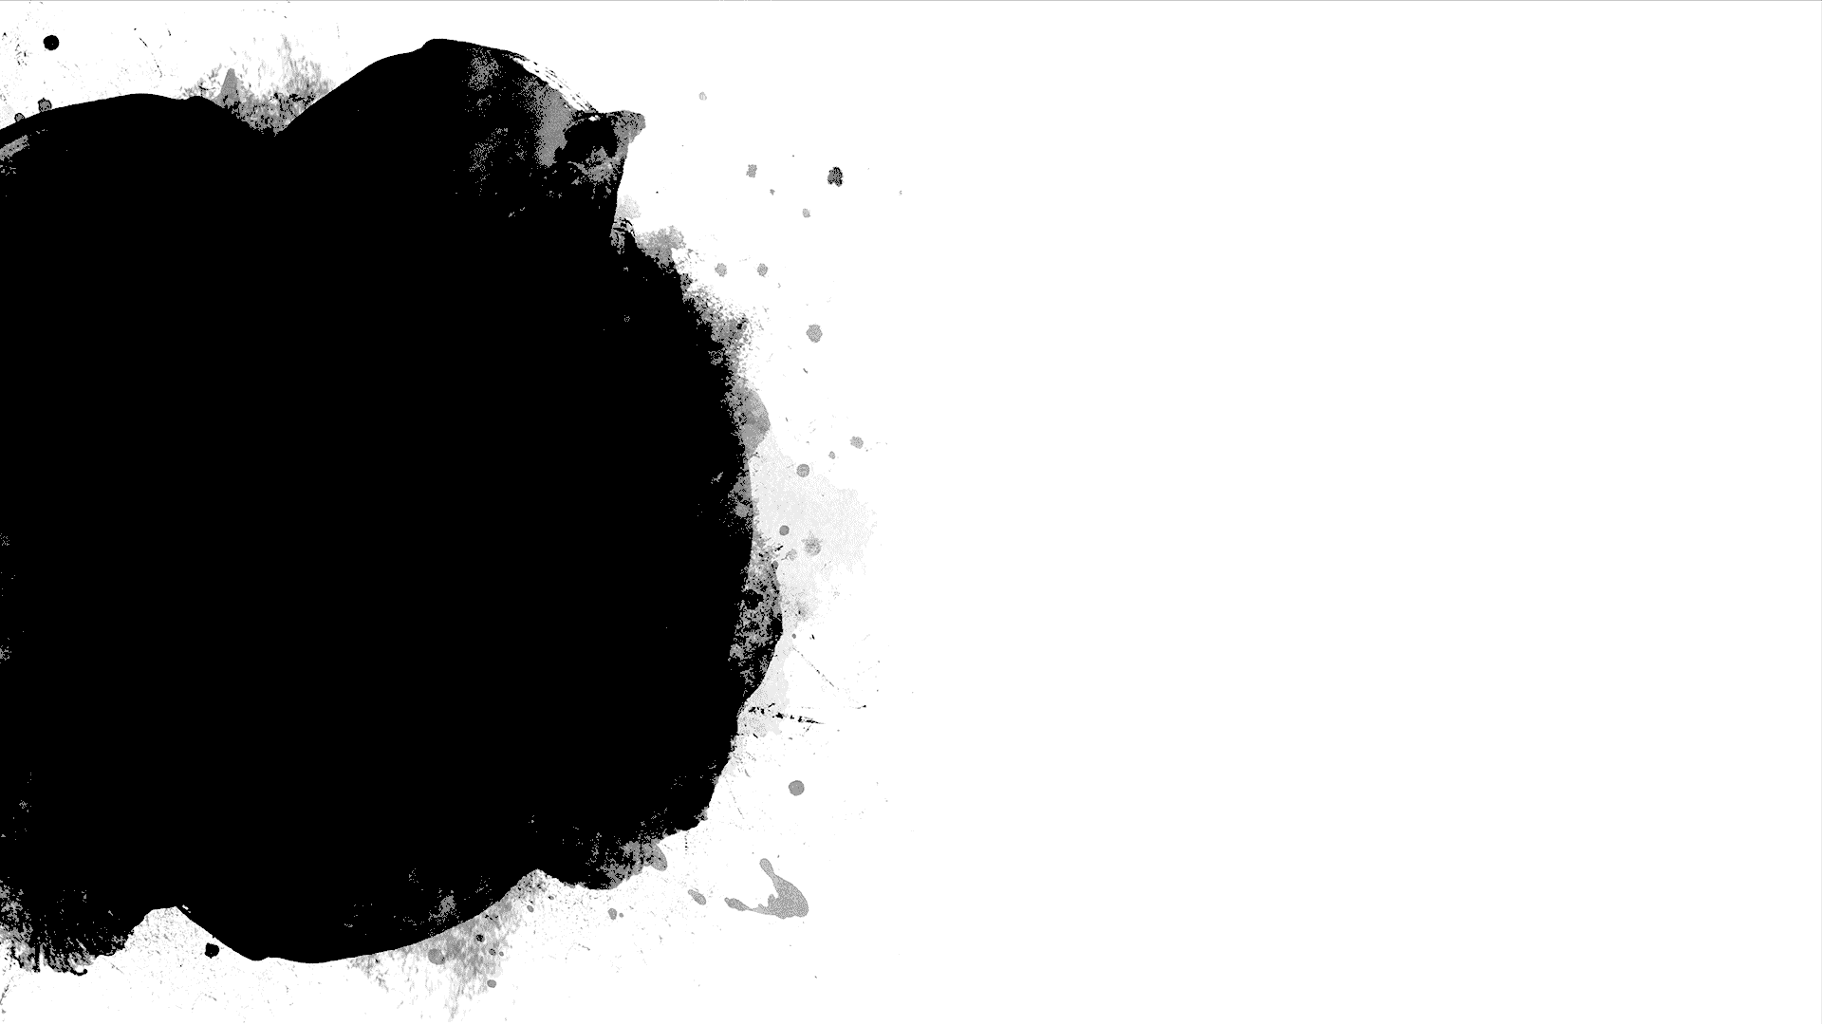
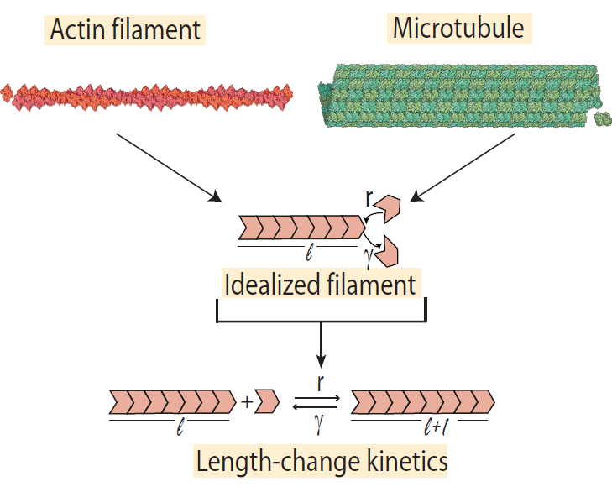
Idealization of Filament
Rate of assembly = r
Rate of disassembly = γ

Slide 4
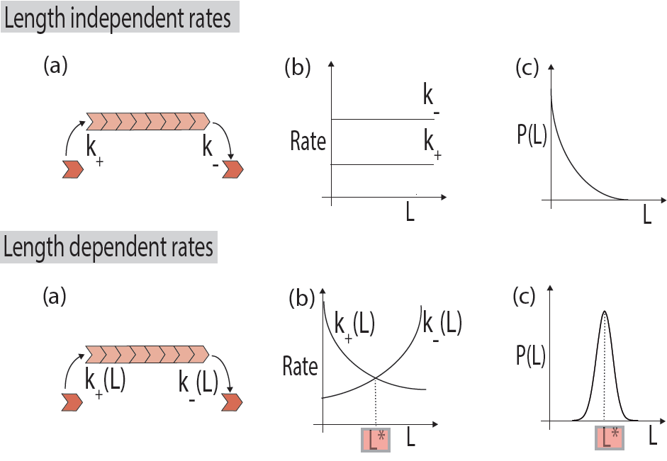
Two possibilities
Rate of assembly > Rate of disassembly
Rate of assembly < Rate of disassembly
How is this related to size control?
r
𝛾
𝛾
r
The filament will shrink faster than it grows, meaning it will SHRINK
The filament will grow faster than it shrinks, meaning it will GROW
If the filament is trying to maintain its size, this will happen when the filament is:
Too Small
Too Big

Slide 5
Unstable!
Stable!
Balancing Assembly & Disassembly
Disassembly
Assembly
Assembly
Disassembly
γ(L)
r(L)
Rate
r(L)
γ(L)
Rate
L*
Length
L*
Length
If we want size control, the disassembly rate must grow with length!

Slide 6
Review: Original Approach
Our original approach was to average the time for ONE depolymerization event to occur at a given length
We then compiled the data from each length and made a “length versus time” plot
This was unsuccessful because the filament was starting “empty,” so the first step always takes longer than subsequent steps
Our initial equations were also wrong because of the way they calculated walk time

Slide 7
Faster association, additional diffuse time (slower for individual protein, faster at high concentration)
k(On)+k(Off)
k(On)*(Number of Monomers)+k(Diffuse)+k(Off)
ONE protein landing, diffusing, falling off
Do this many times for each monomer→ Avg time for a protein to diffuse to end of filament of this length
Do this many times for each filament→ Avg time for a protein to diffuse to end of filament of multiple lengths
MULTIPLE proteins landing, diffusing, falling off (once ONE protein reaches the end)
MULTIPLE proteins landing, diffusing, falling off (once ONE protein reaches the end)
Concentration
Length

Slide 8
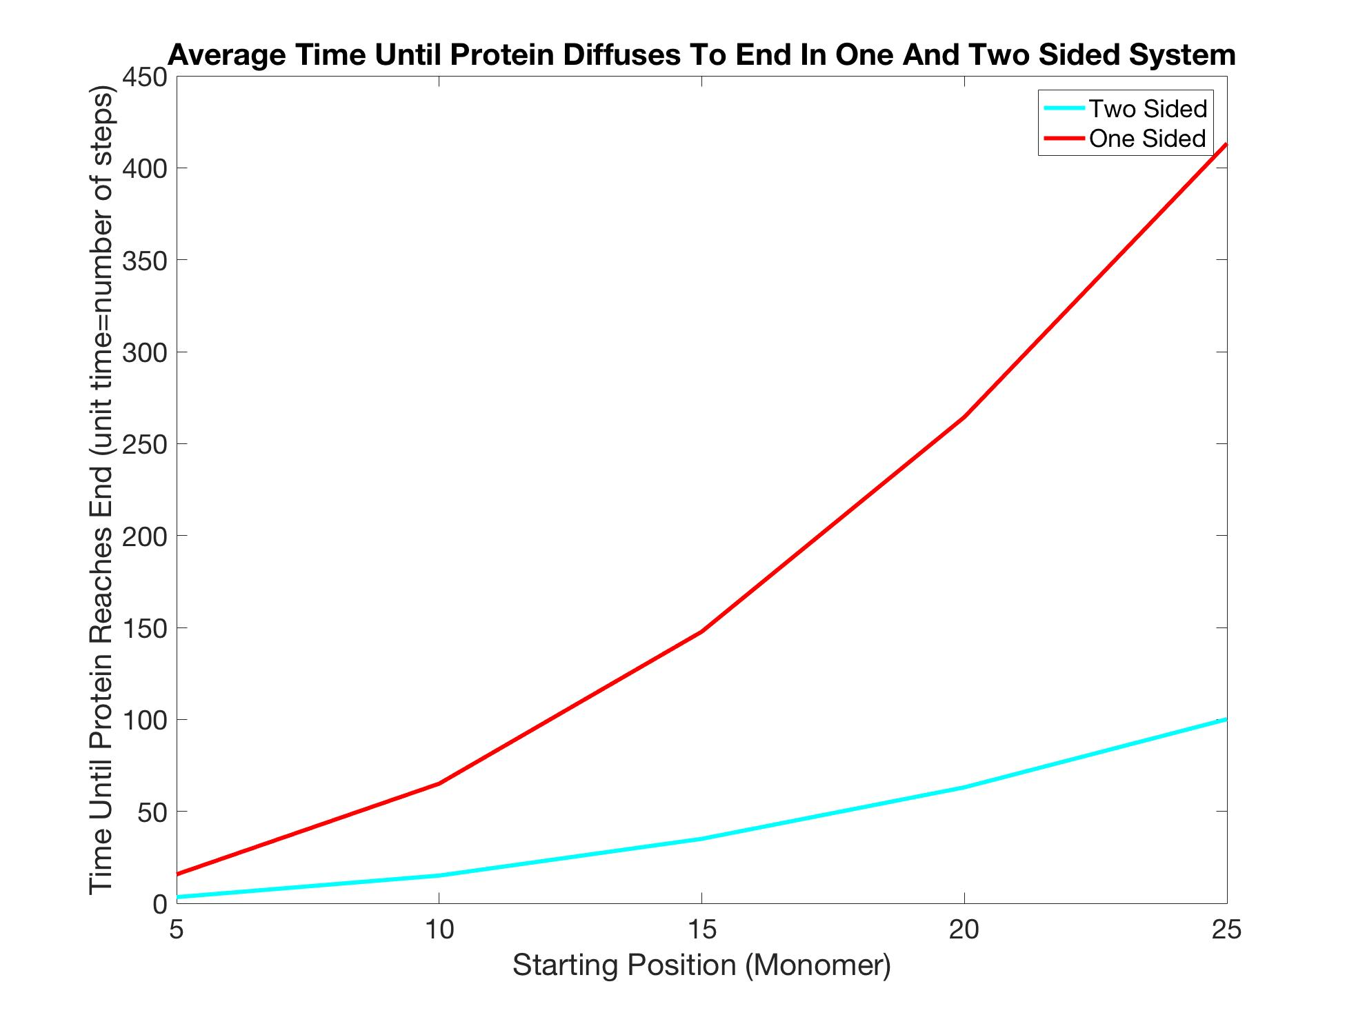
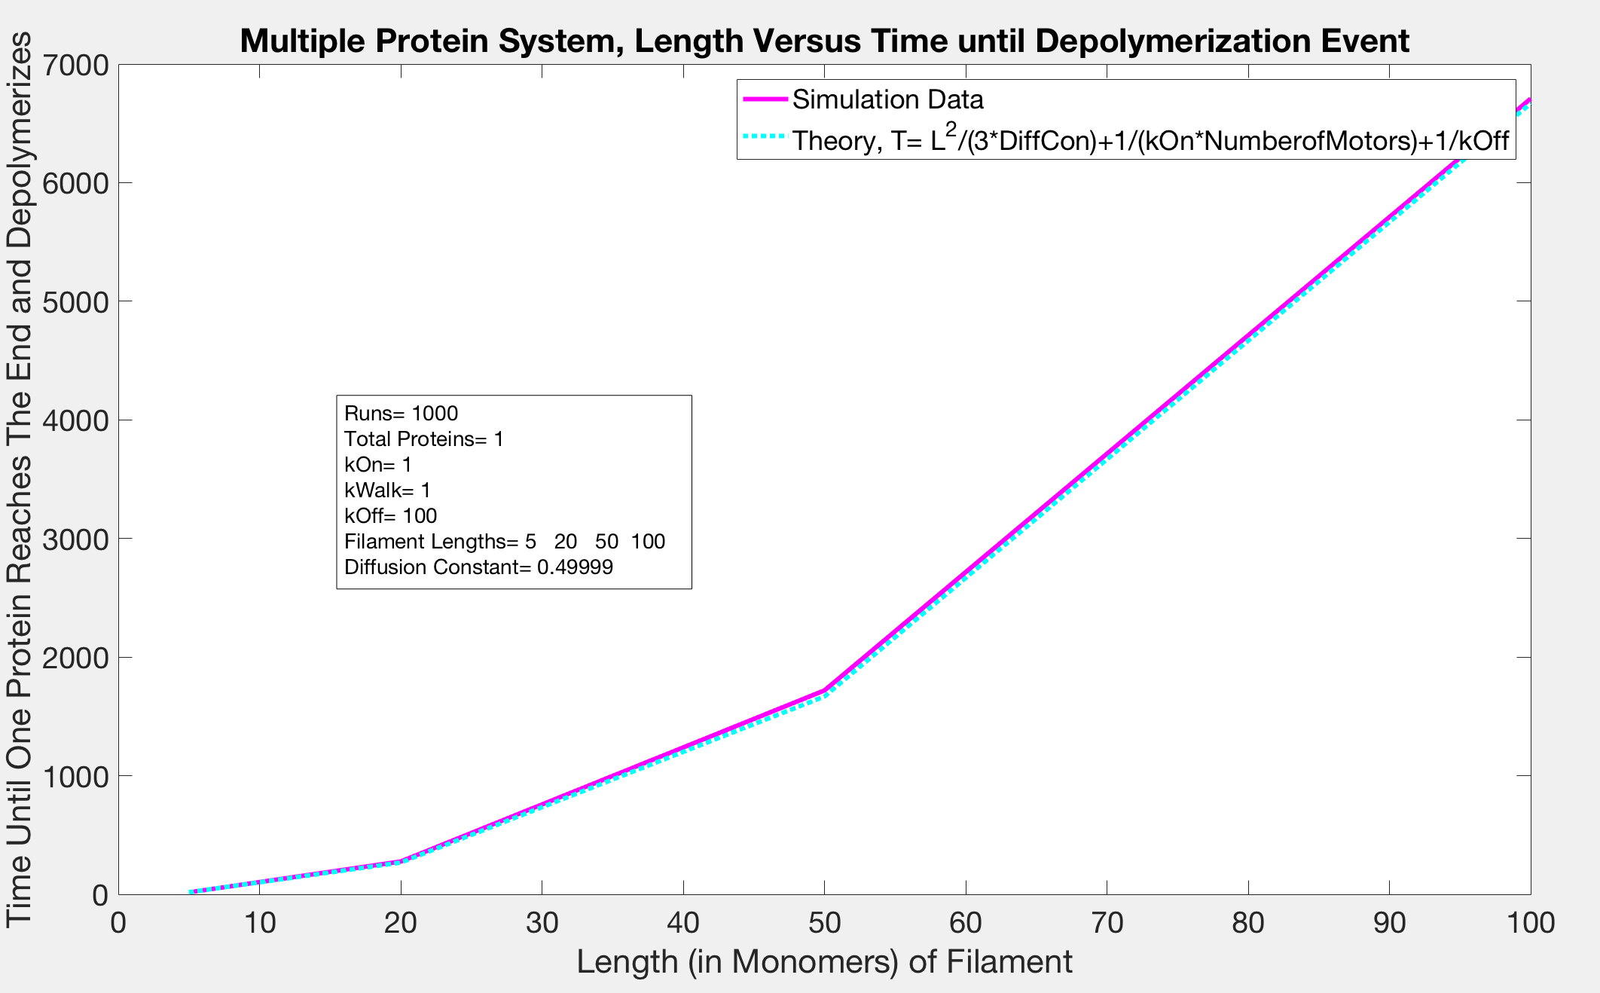
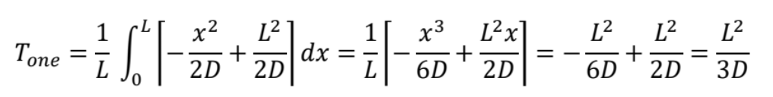
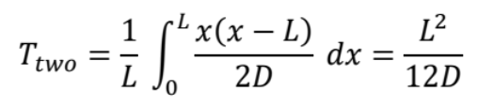
+
+
T (0n)
T (Diffuse)
T (Off)
=
T
Length of Filament (in monomers)
The simulation was consistent with our calculations when there was only one protein in the system

Slide 9
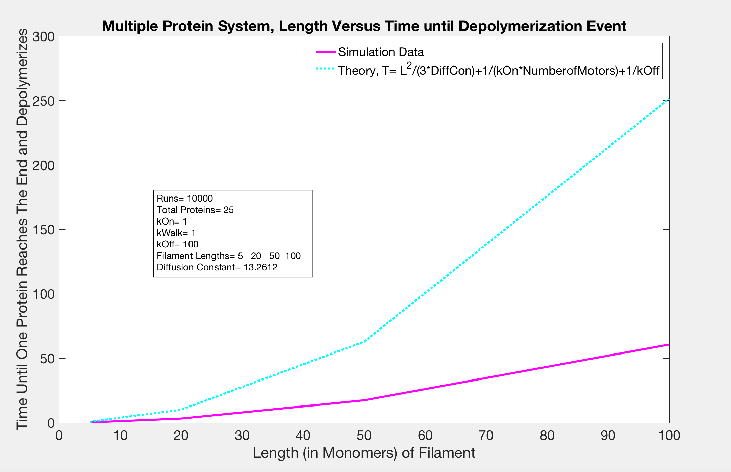
Once we added more than one protein to the system, our calculations were no longer consistent

Slide 10
NOW
We are looking at a system as it depolymerizes multiple times
We have to come up with new calculations to describe what we see
Th following graphs show how quickly filaments shrink with different lengths and concentrations

Slide 11
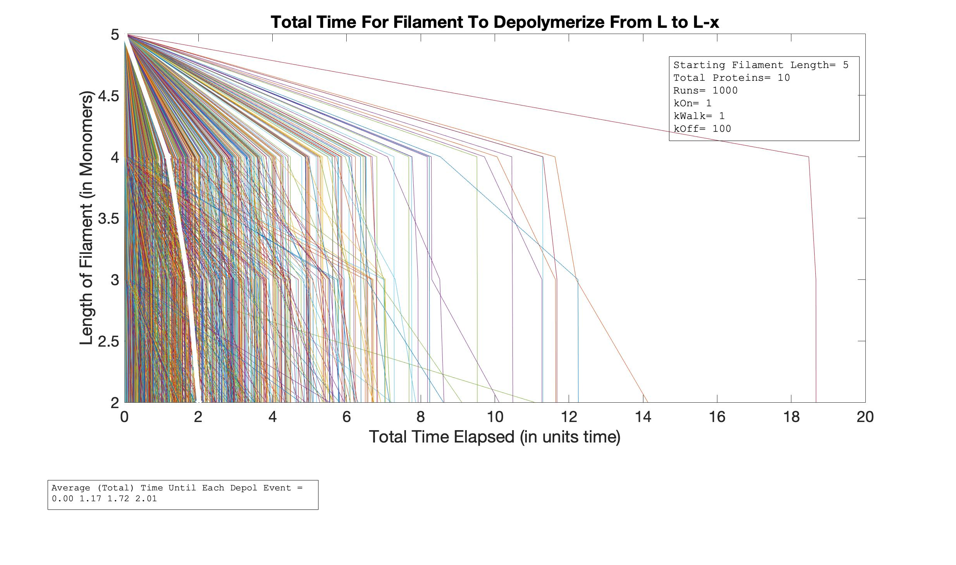
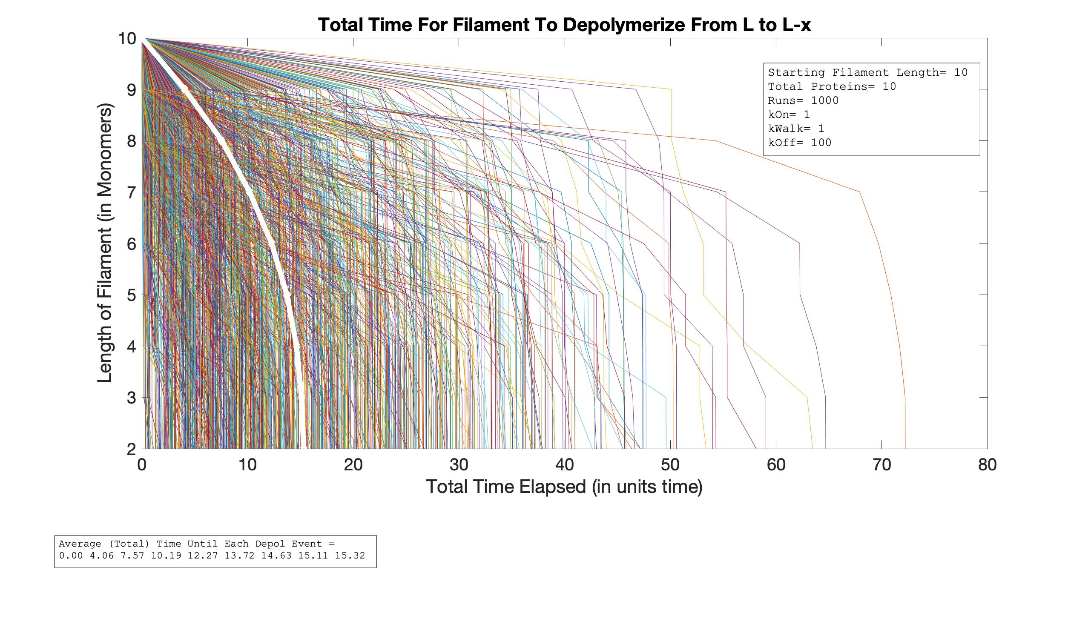
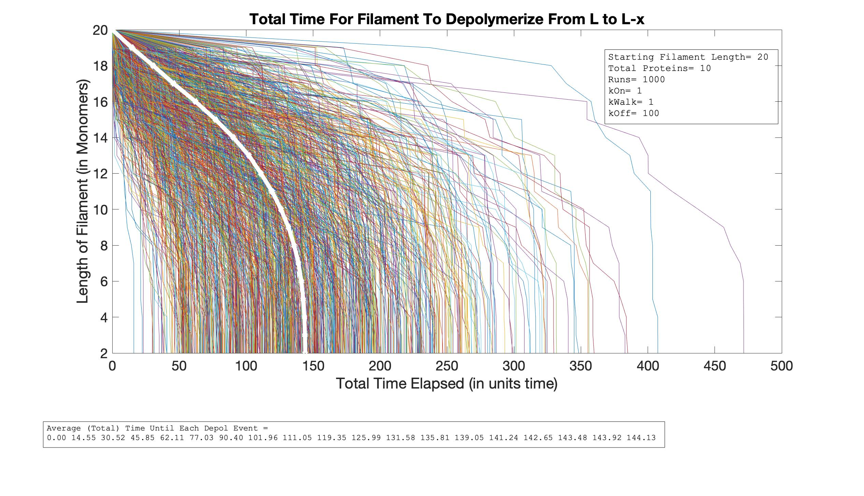
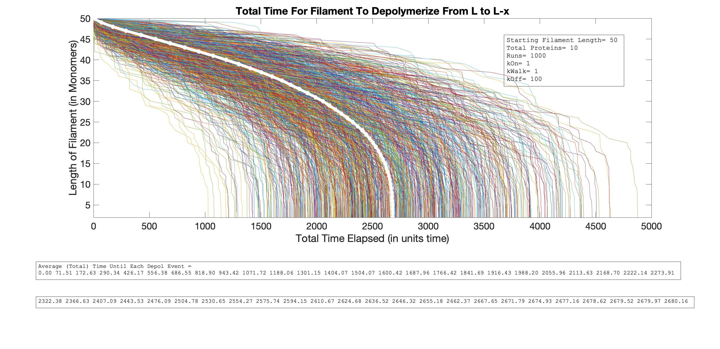
Total Time vs. Length
As L Increases
L=5
L=10
P=10
L=50
L=20

Slide 12
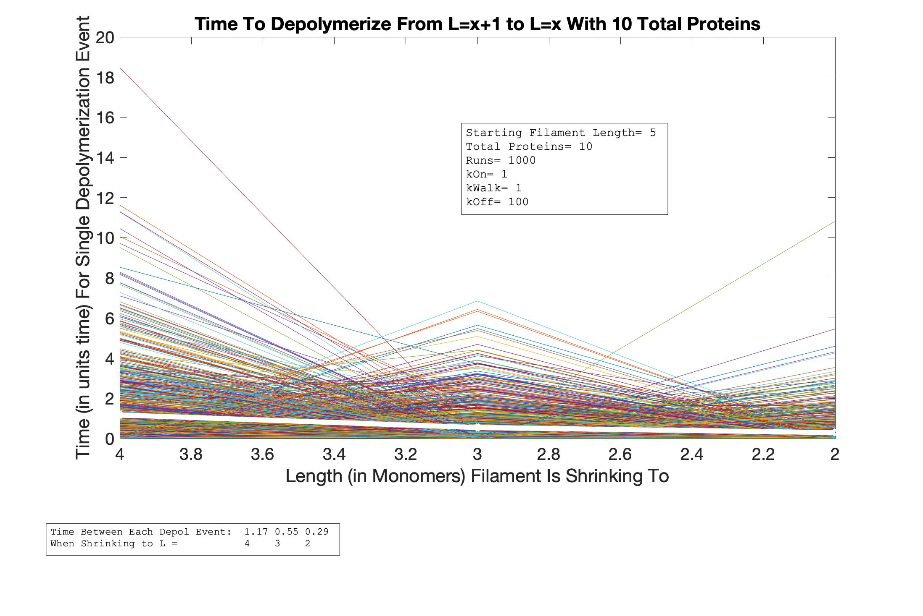
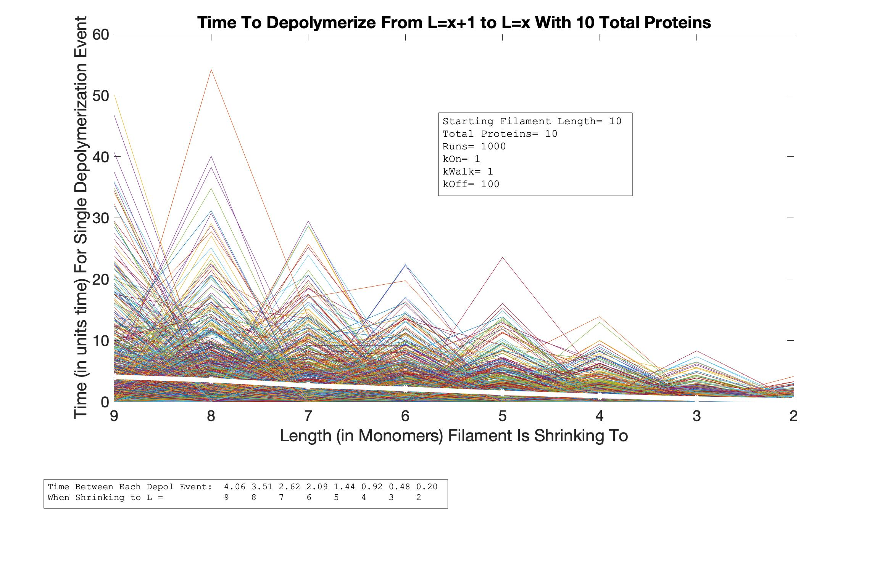
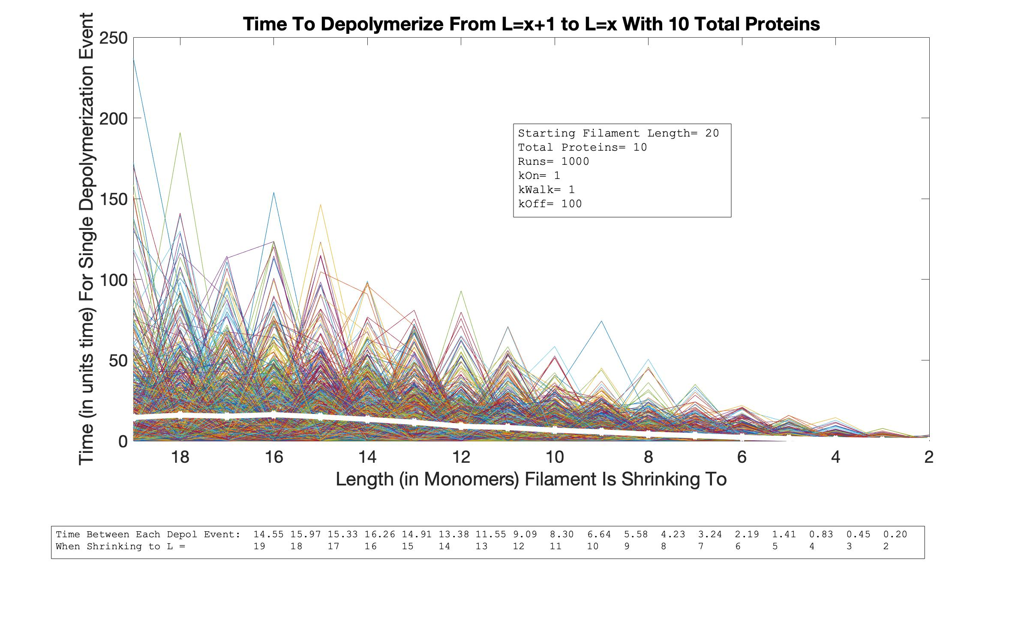
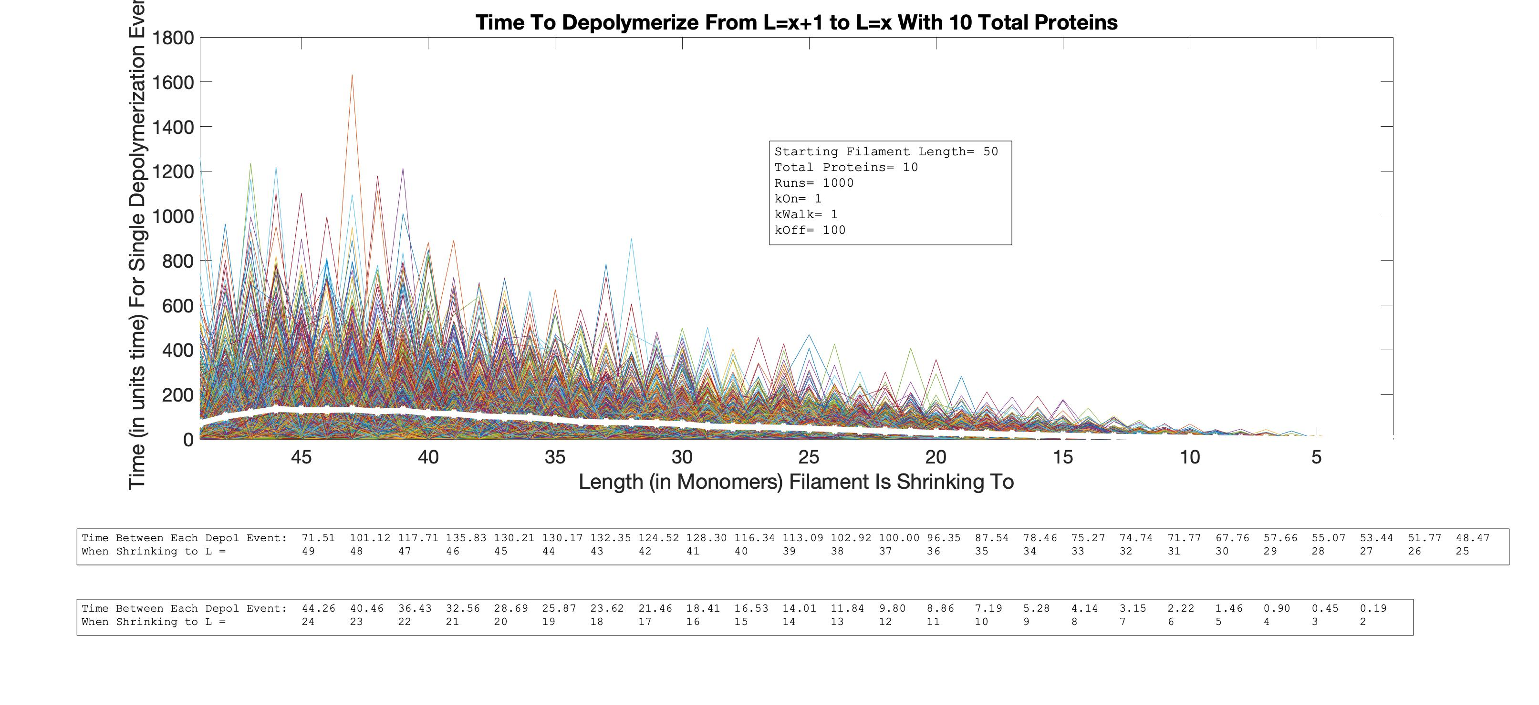
Single Depol Event Time vs. Length
As L Increases
L=5
L=10
P=10
L=50
L=20

Slide 13
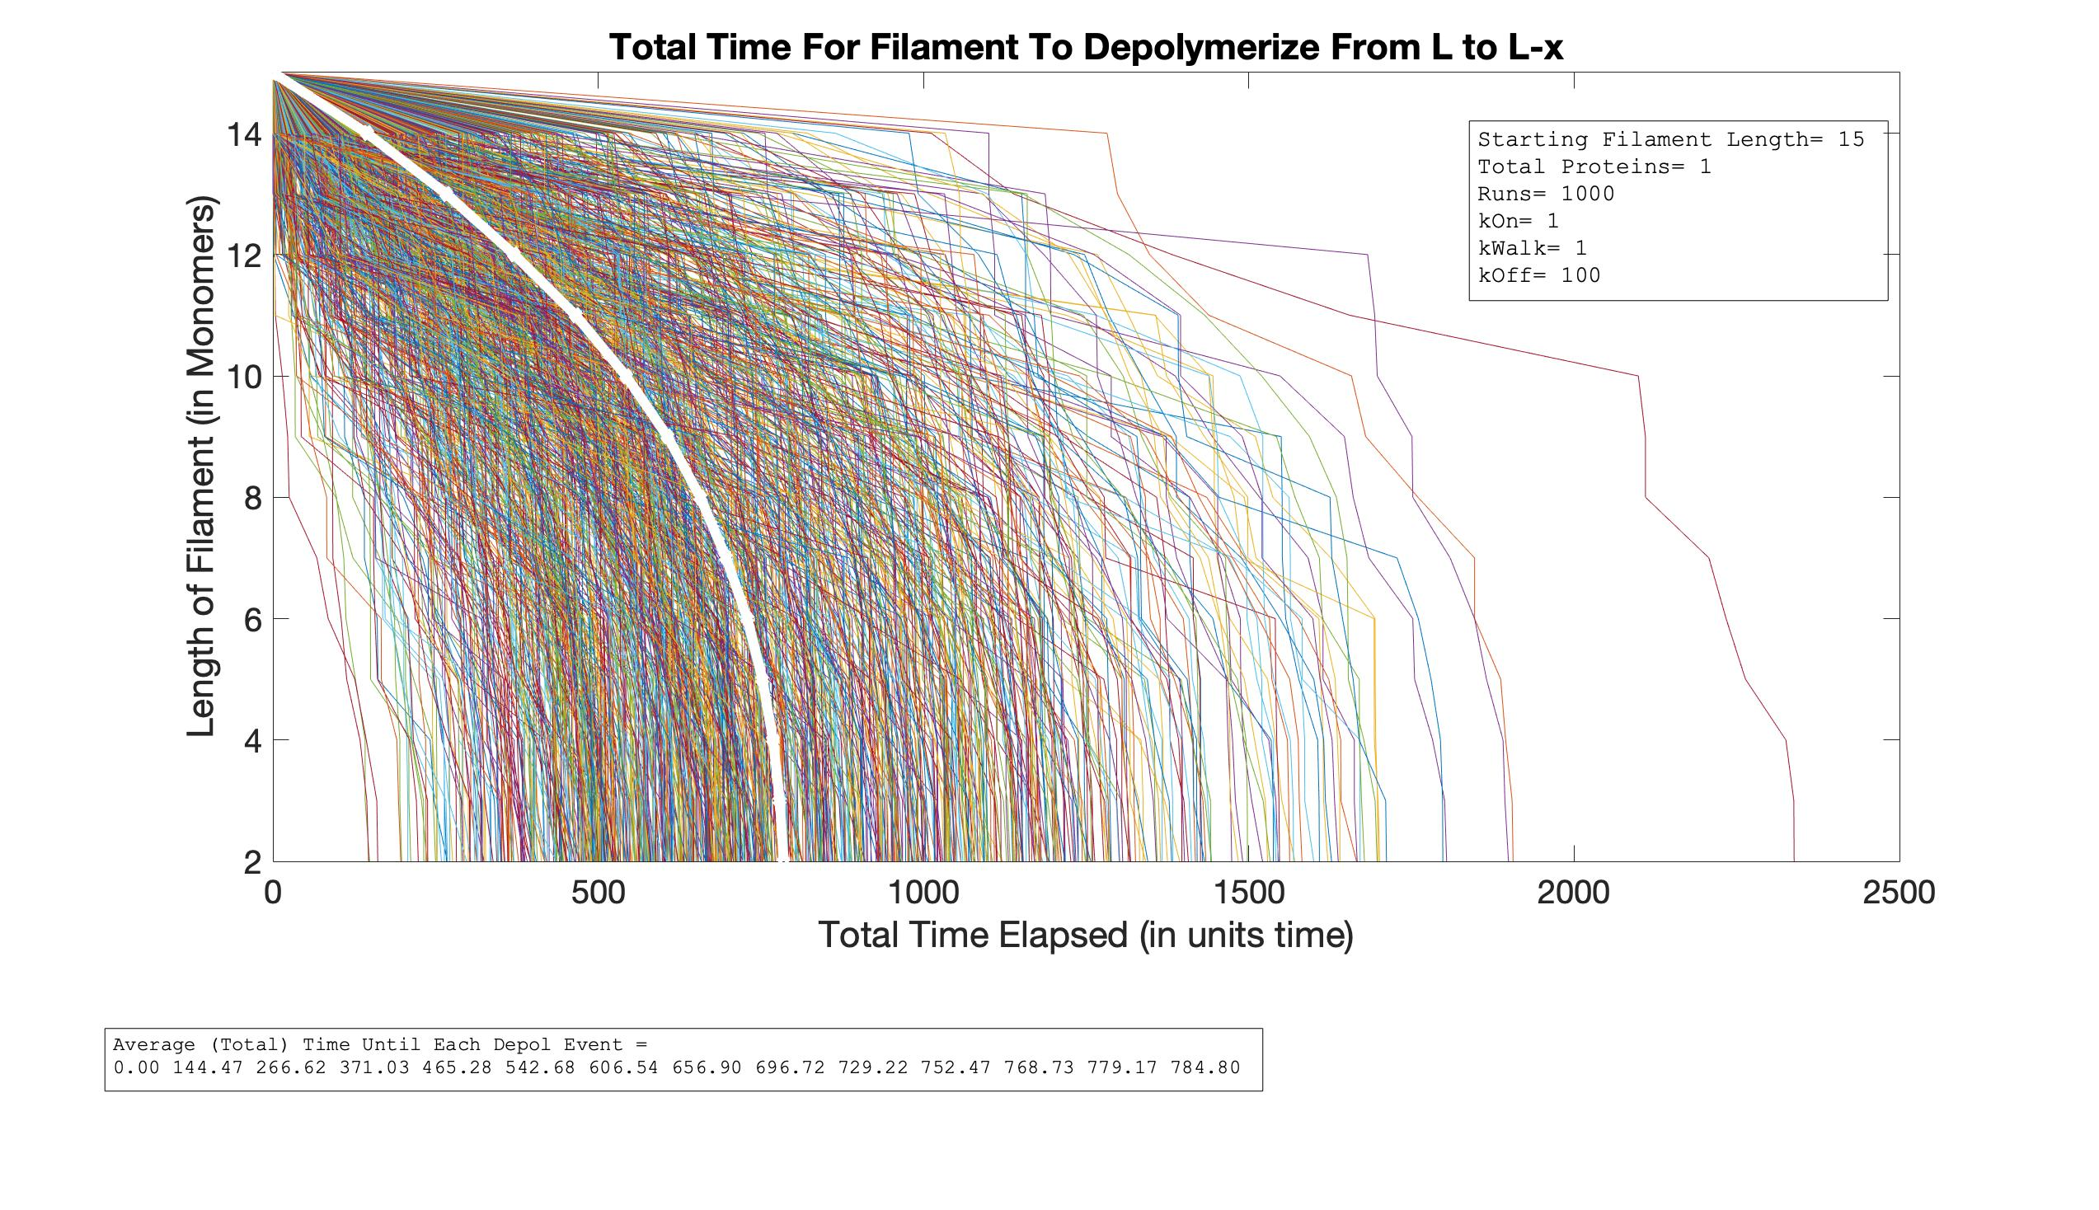
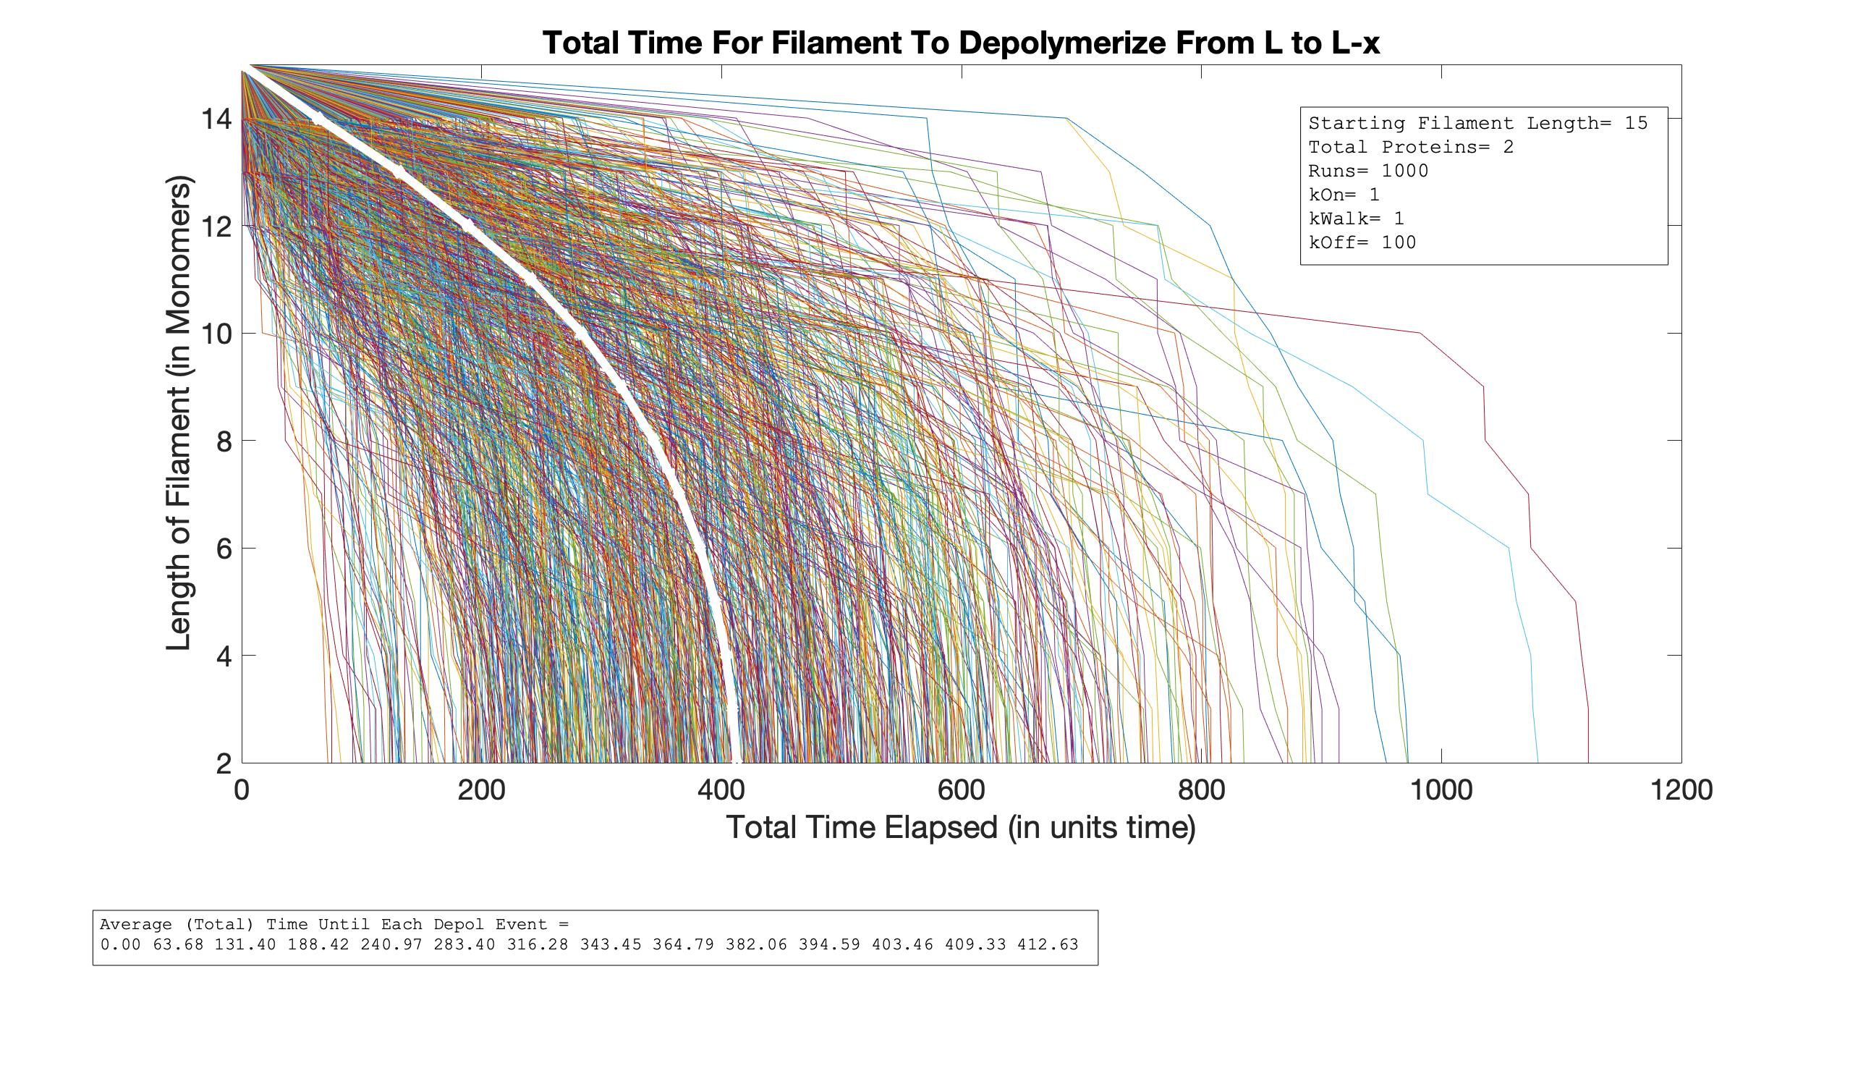
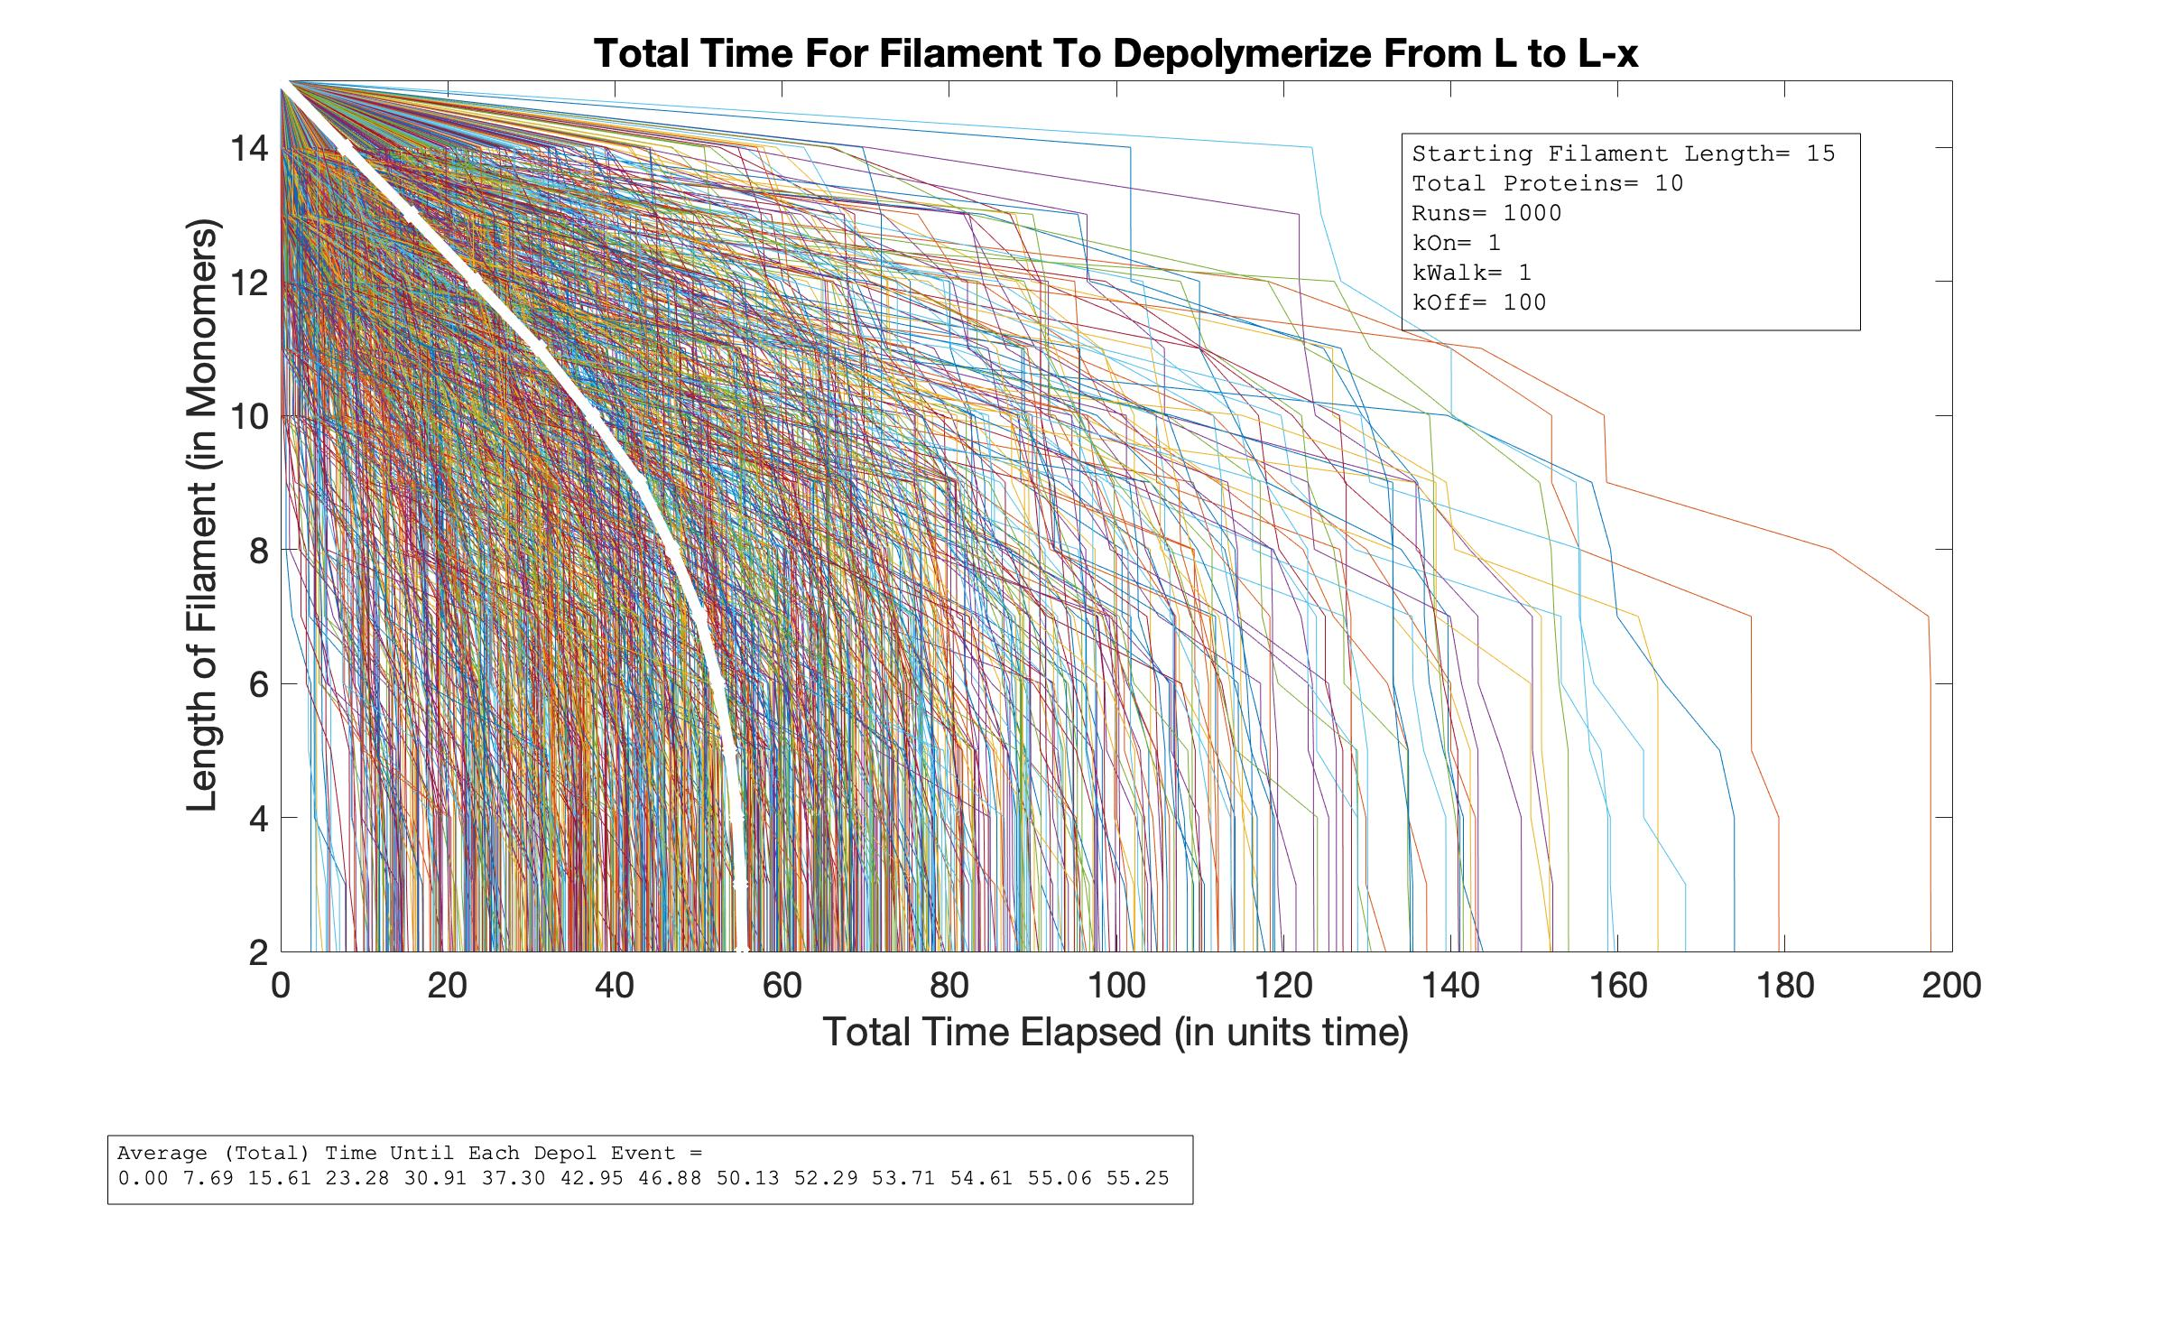

Total Time vs. Length
As P Increases
P=1
P=2
L=15
P=5
P=10

Slide 14
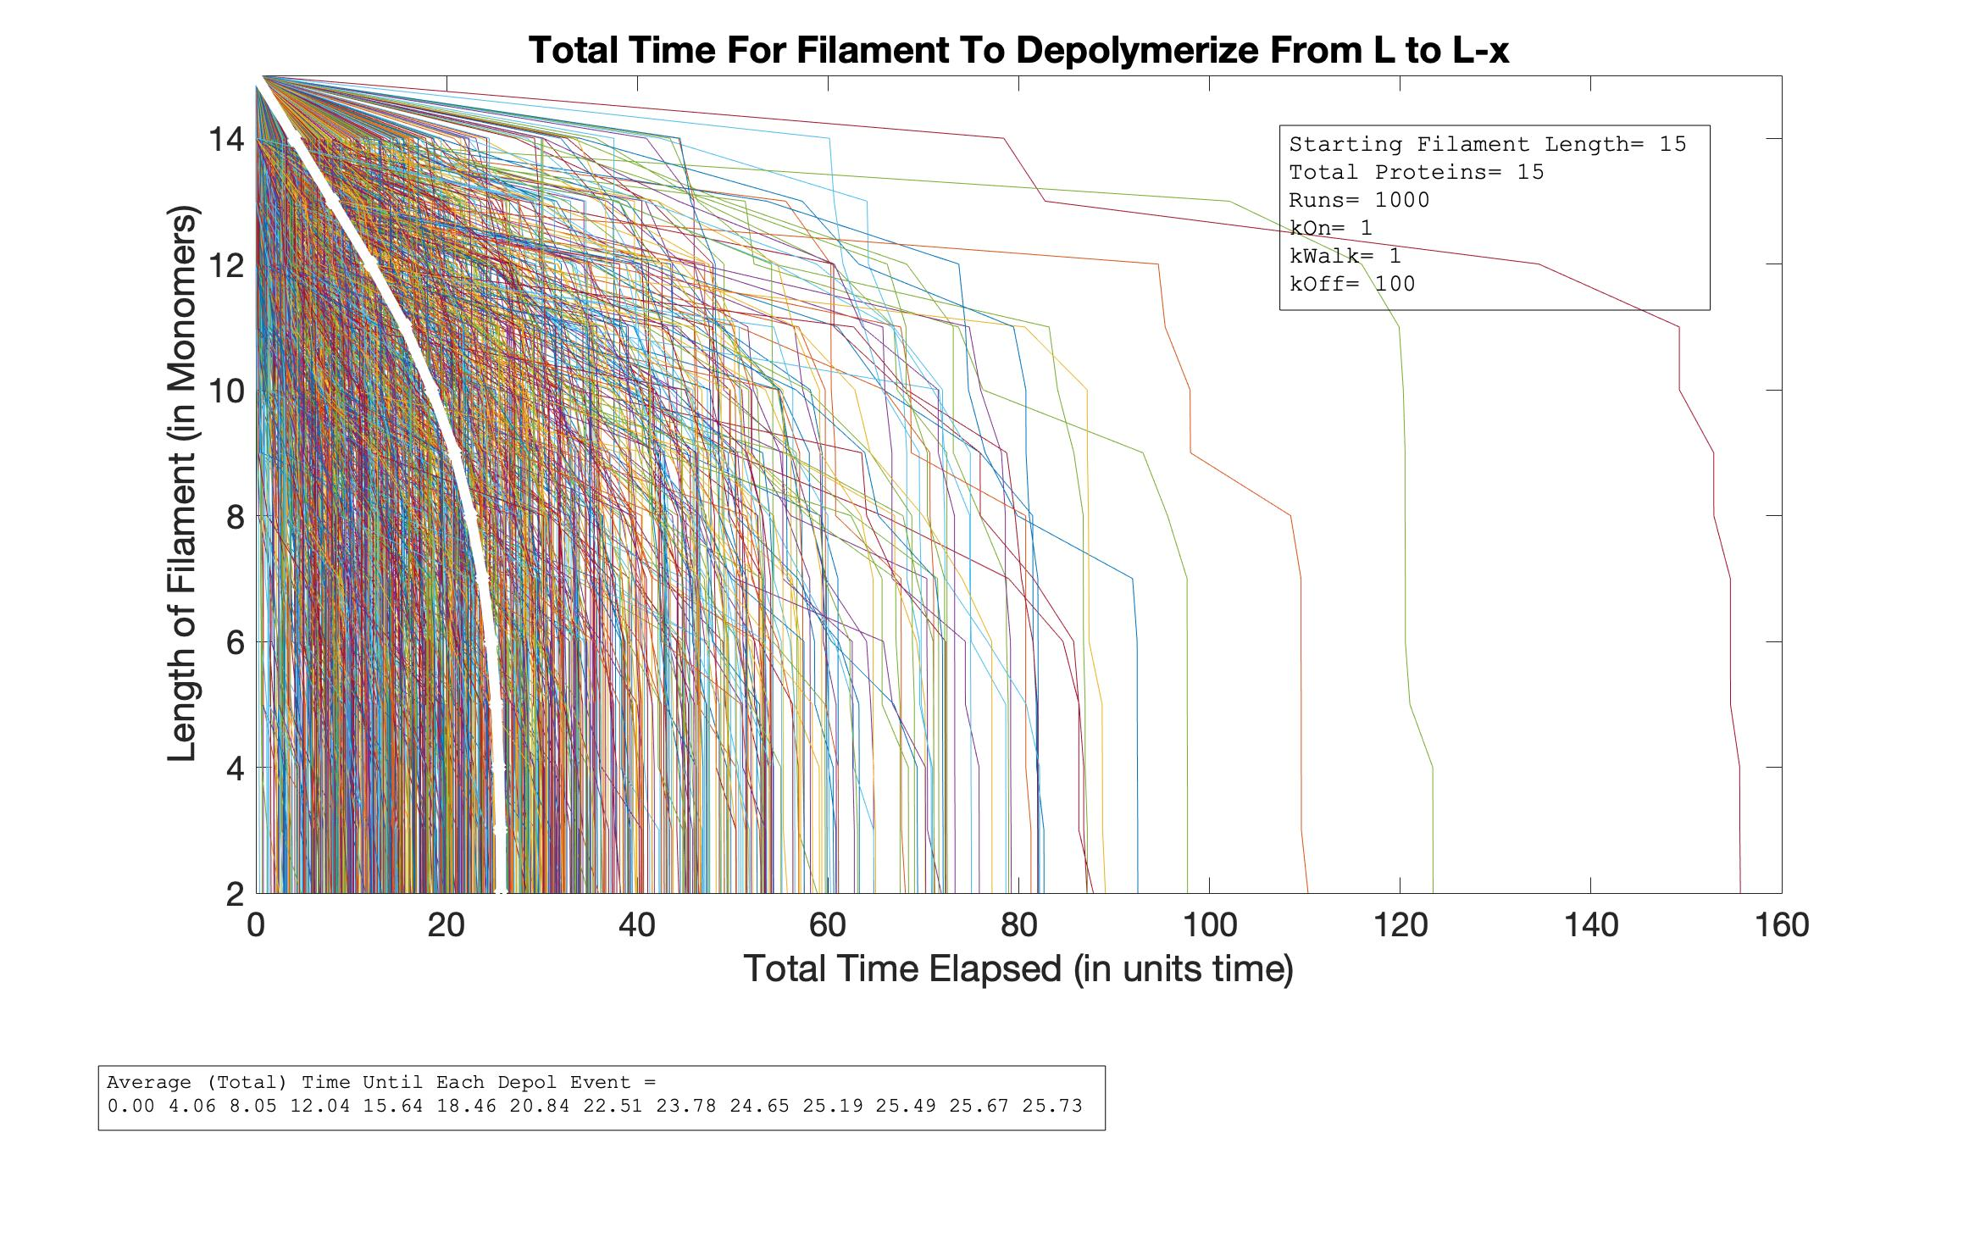
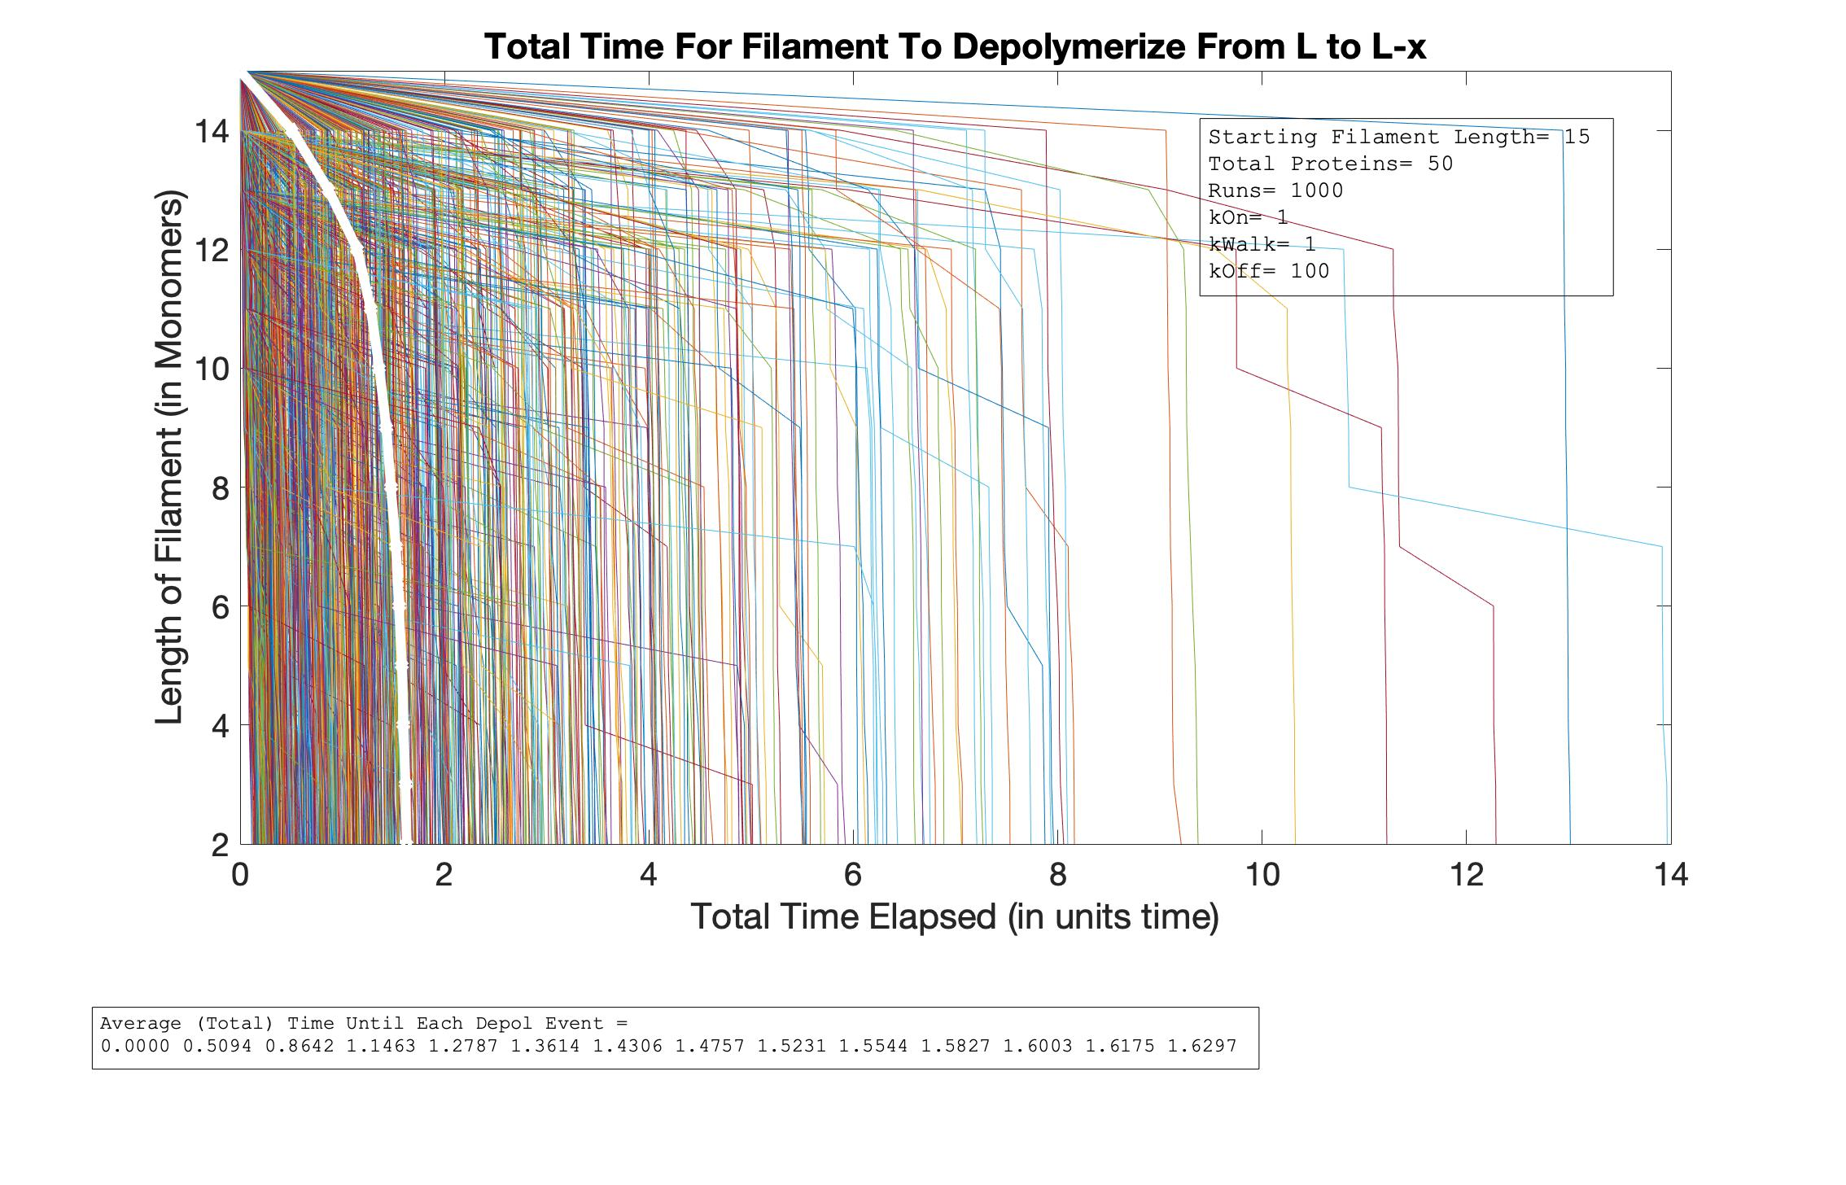
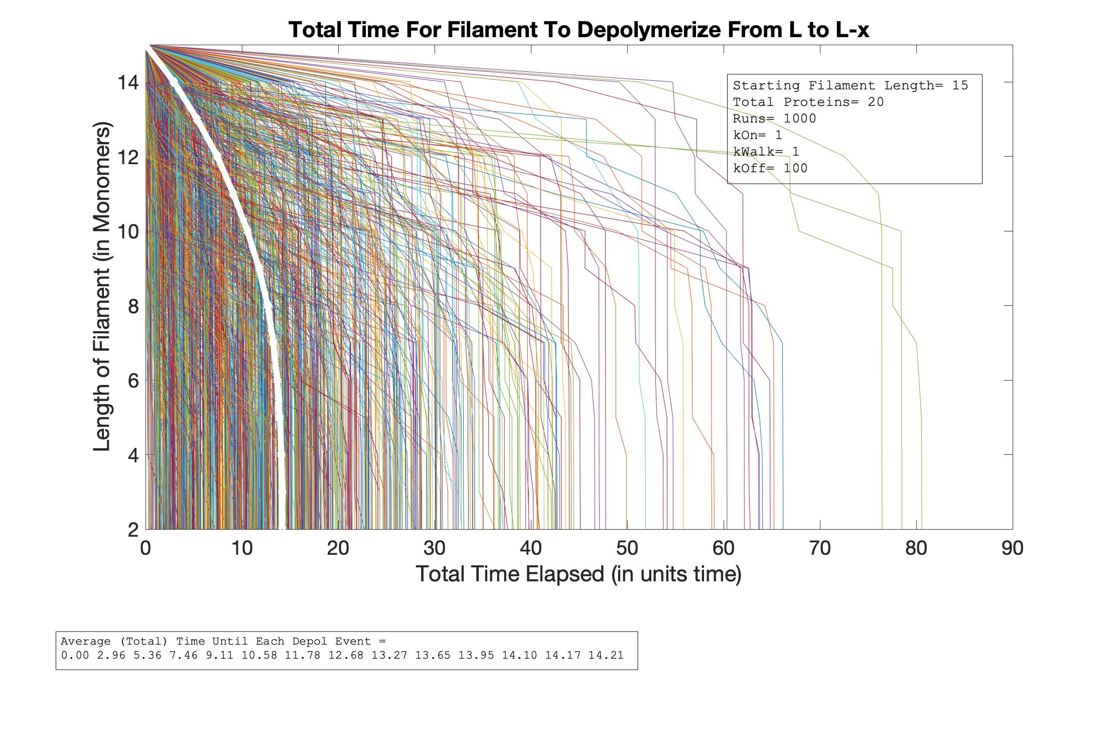
Total Time vs. Length
As P Increases
P=15
L=15
P=50
P=20

Slide 15
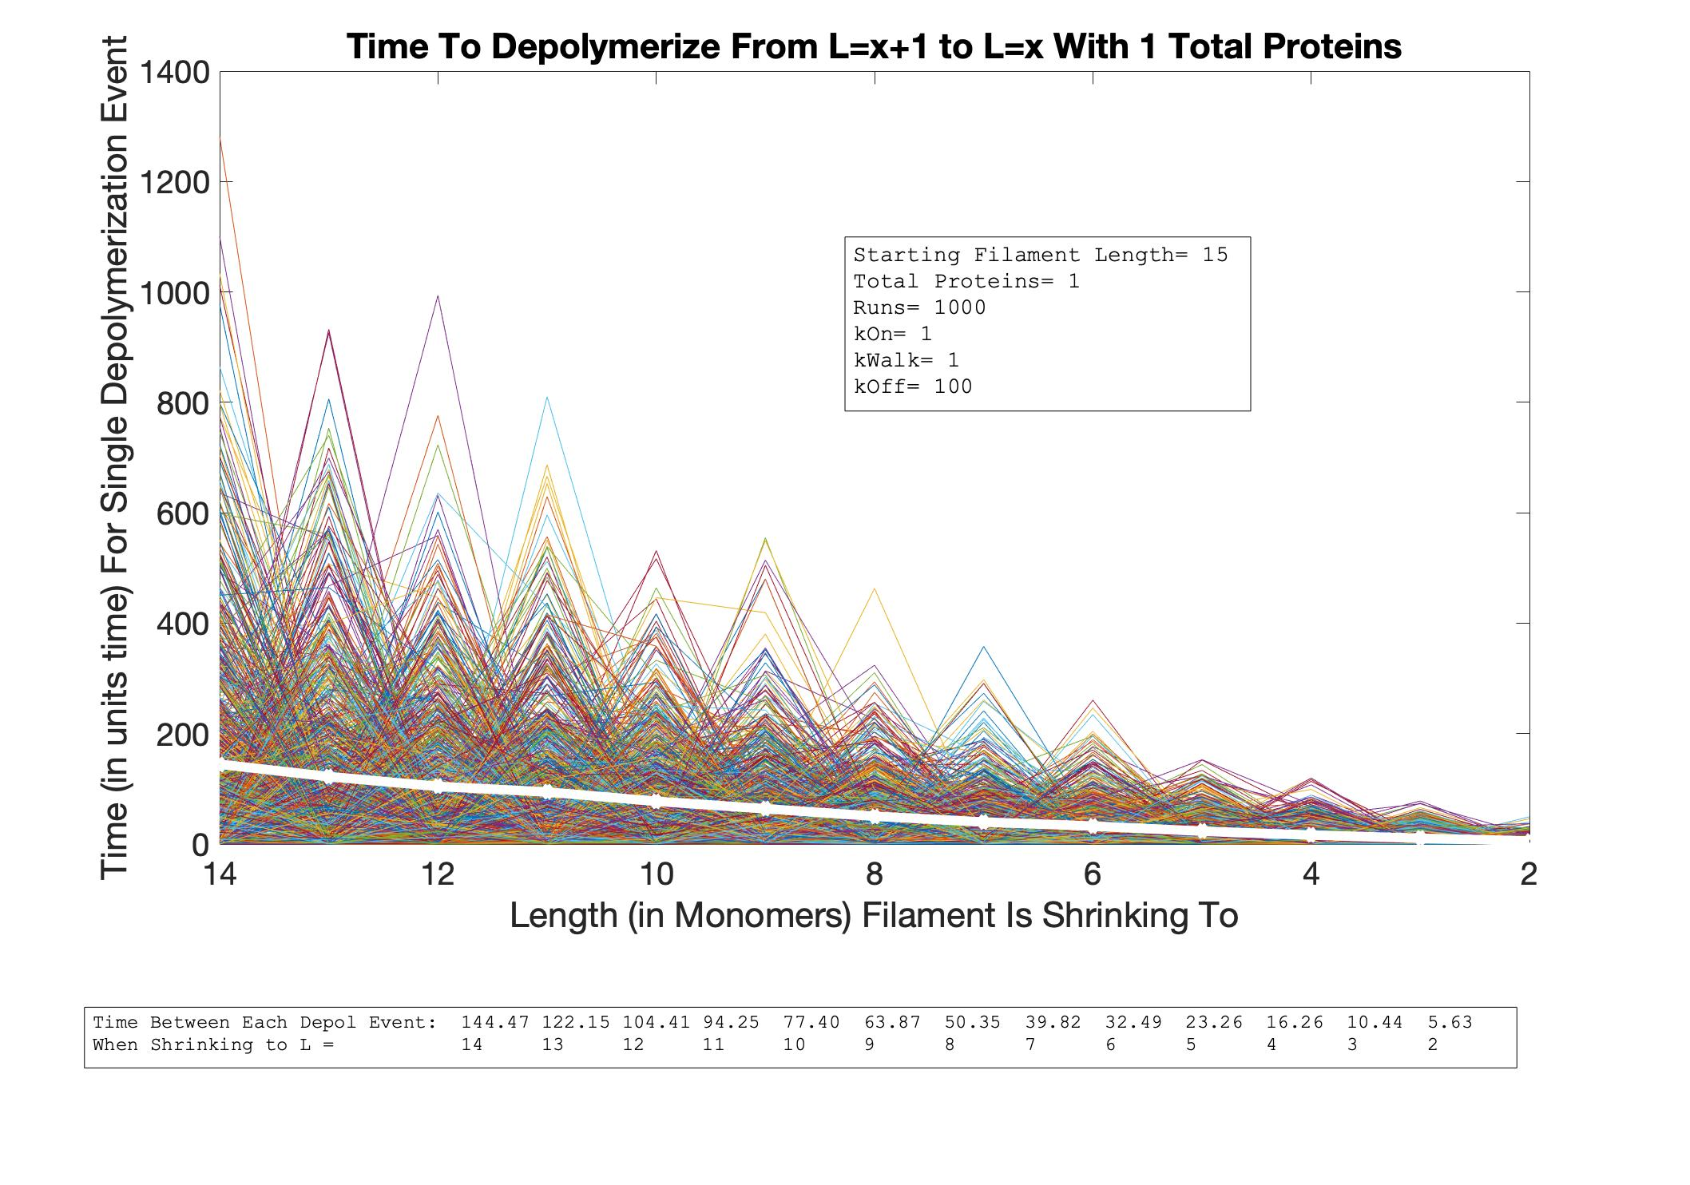
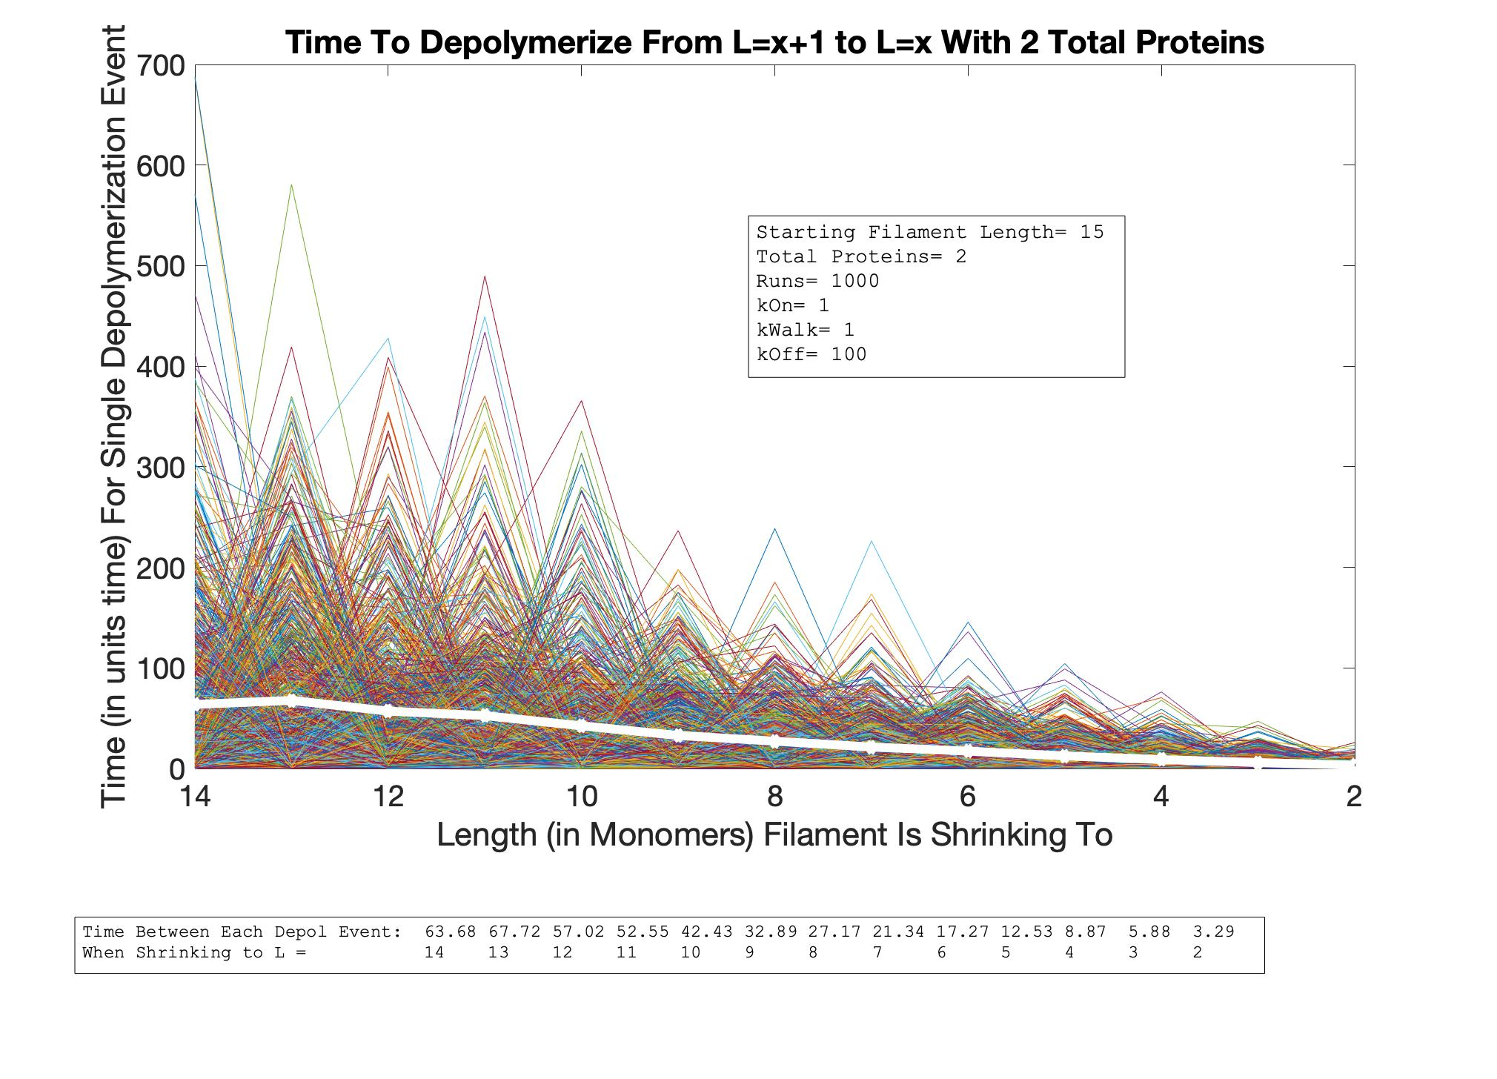
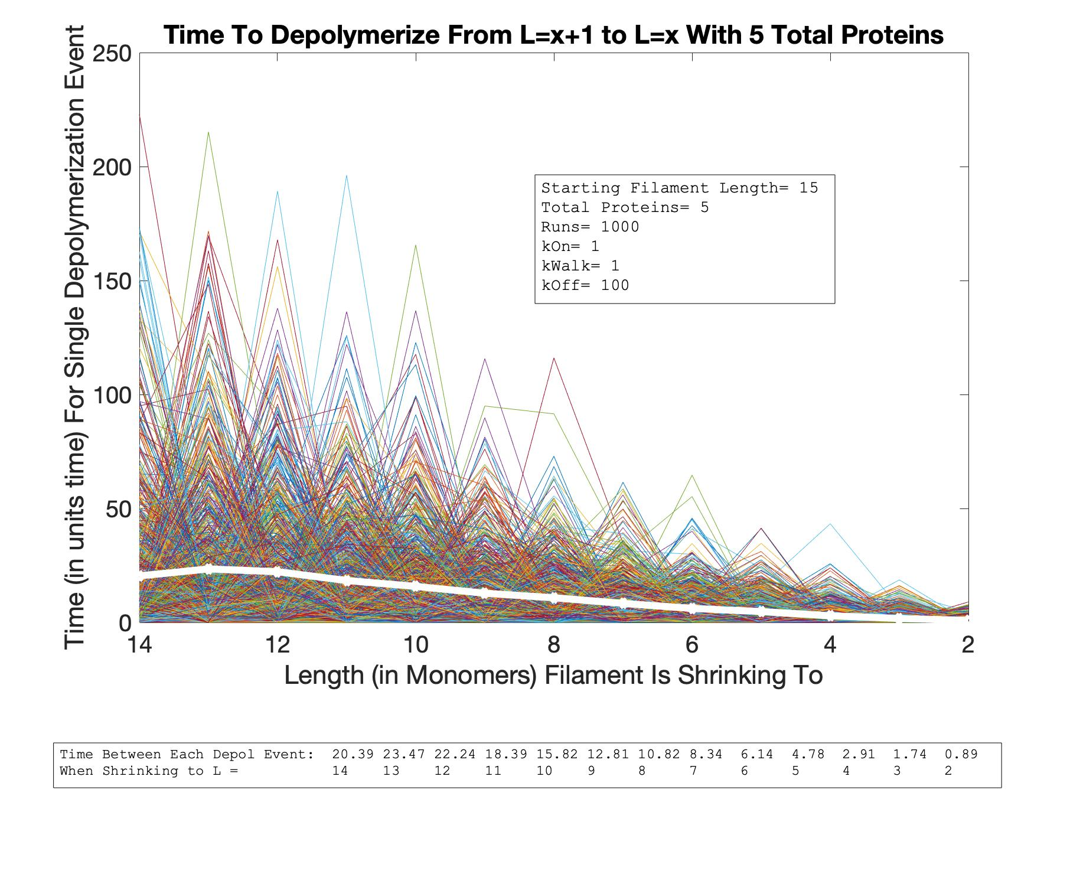
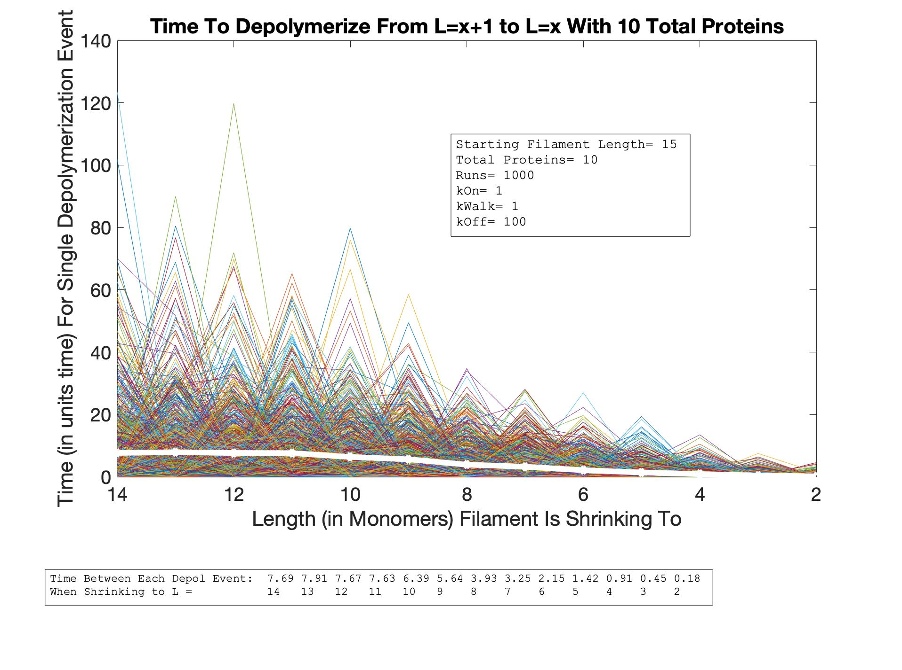
Single Depol Event Time vs. Length
As P Increases
P=1
P=2
L=15
P=5
P=10

Slide 16
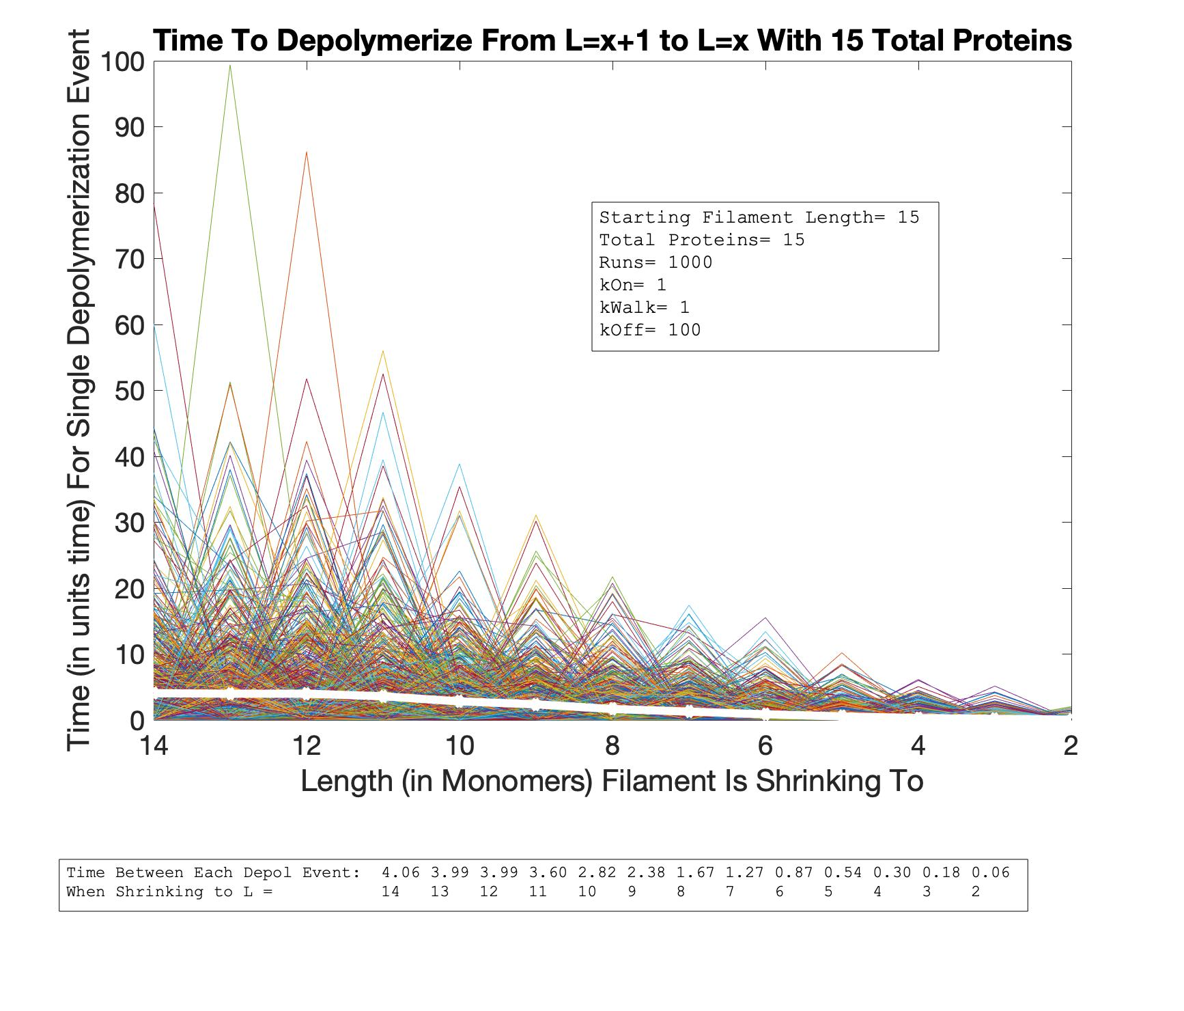
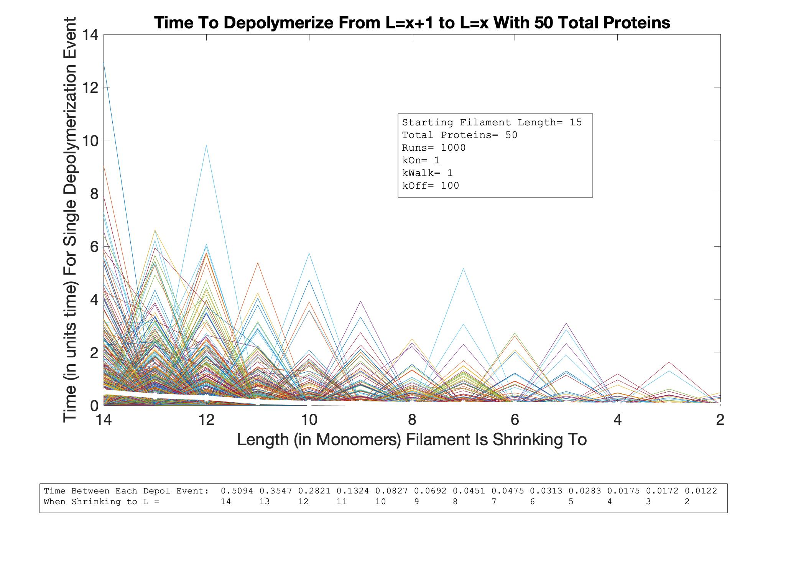

Single Depol Event Time vs. Length
As P Increases
P=15
L=15
P=50
P=20

Slide 17
Initial Length
L=5 | L=10 | L=15
0.8547, L=4 1.8181, L=3 3.448, L=2 | 0.246, L=9 0.478, L=6 5.0, L=2 | 0.0687, L=14 0.120, L=11 5.0, L=2
Depol Rate at Start, midpoint, and end
Number of Proteins
P=1 | P=2 | P=5 | P=10 | P=15 | P=20 | P=50
144.4700 50.3500 5.6300 | 63.6800 27.1700 3.2900 | 20.3900 10.8200 0.8900 | 7.6900 3.9300 0.1800 | 4.0600 1.6700 0.0600 | 2.9600 0.8900 0.0400 | 0.5094 0.0451 0.0122
Depol Rate at Start, midpoint, and end (L=14, L=8, L=2)

Slide 18
Graphed:
Total Time vs. Length of Filament (LVT)
Depolymerization Rate (Between L & (L-1) ) vs. Length of Filament (LVD)
For:
STARTING LENGTHS:
5
10
15
20
NUMBER OF PROTEINS:
5
10
15
20
5
10
15
20
5
10
15
20
5
10
15
20

Slide 19
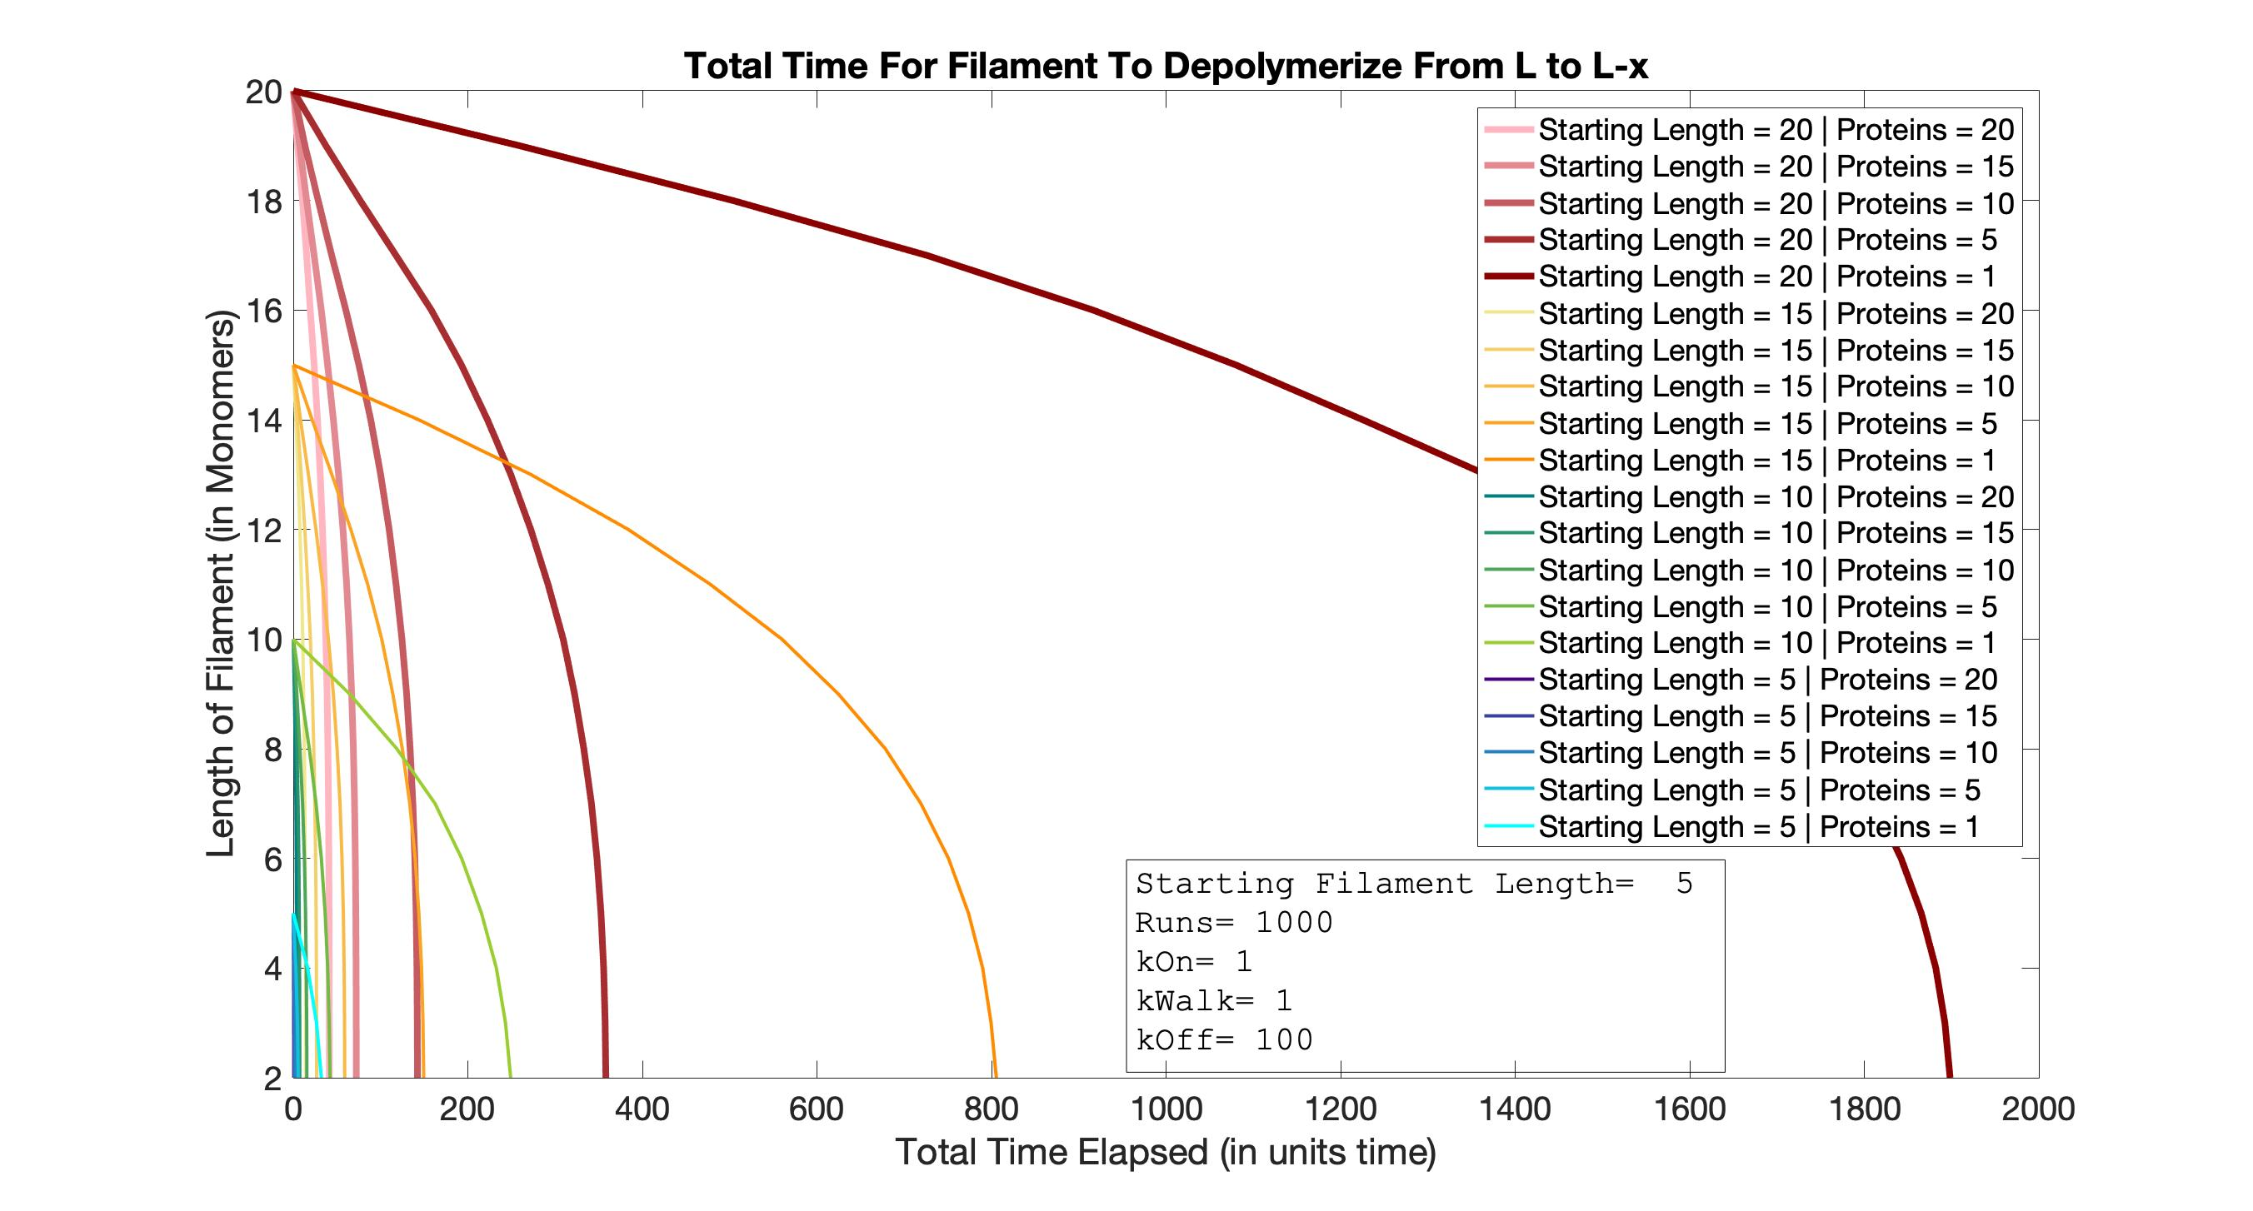
Time vs. Length
All Lengths
All Protein Concentrations

Slide 20
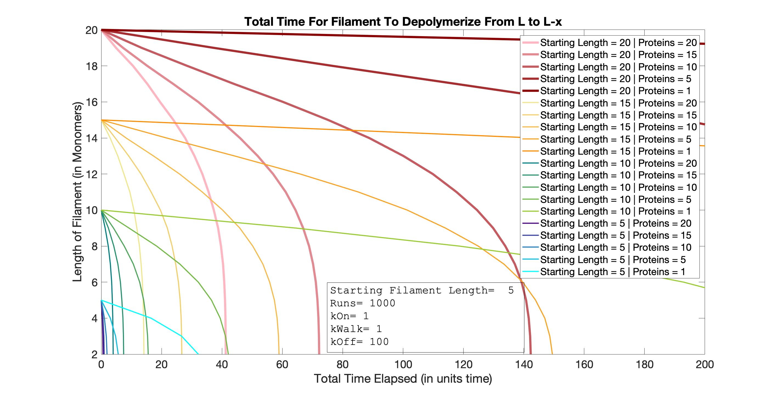
Time vs. Length
All Lengths
All Protein Concentrations
ZOOM 1

Slide 21
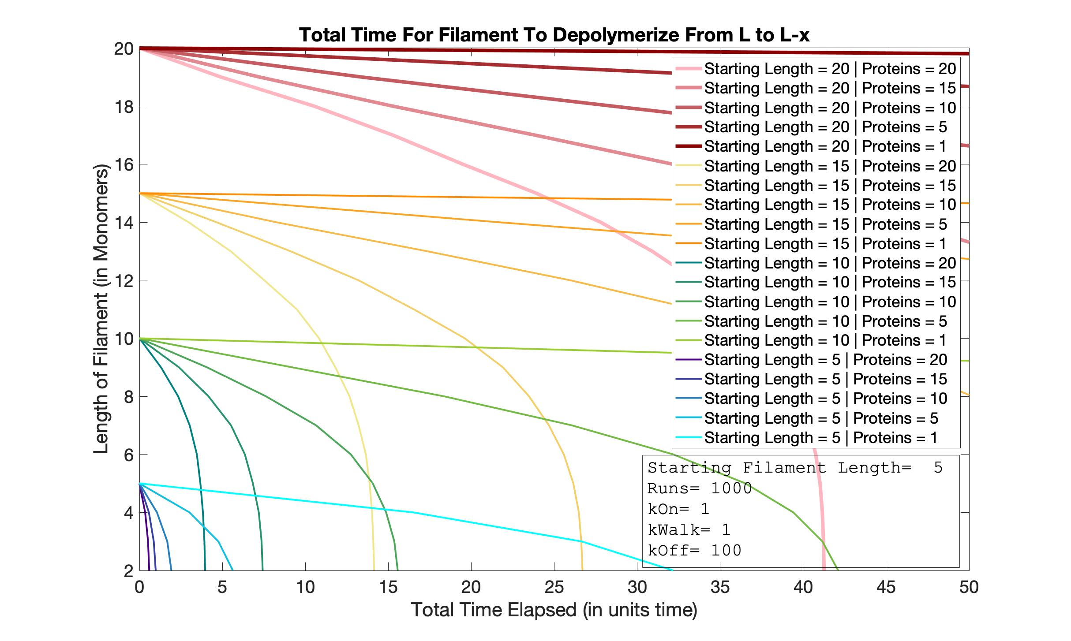
Time vs. Length
All Lengths
All Protein Concentrations
ZOOM 2

Slide 22
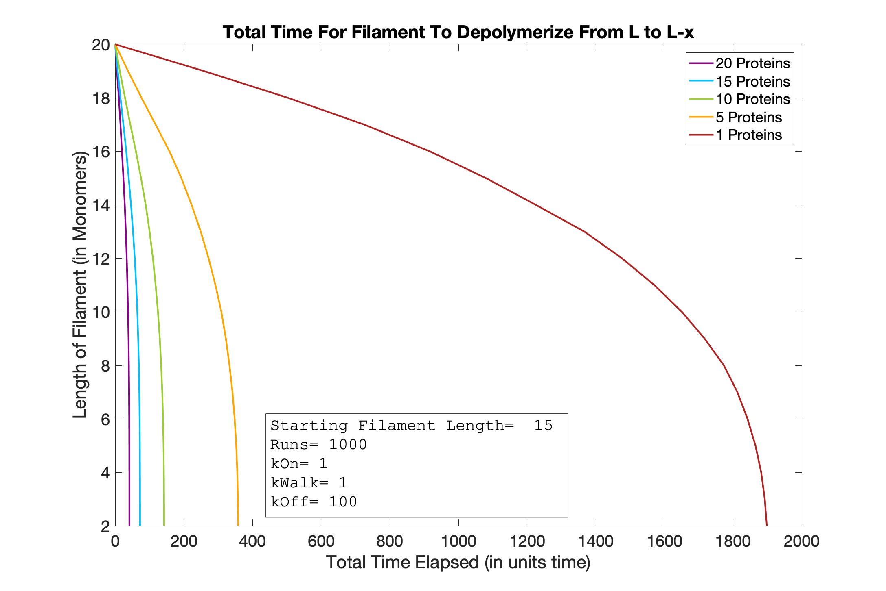
Time vs. Length
L=20

Slide 23
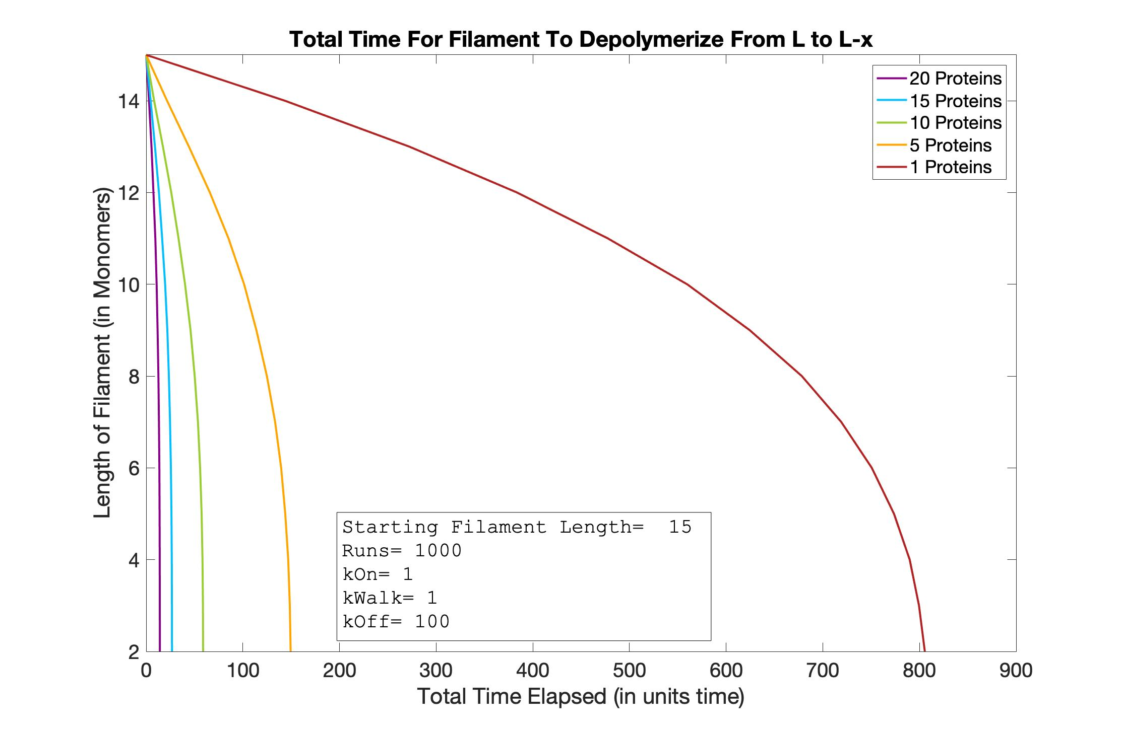
Time vs. Length
L=15

Slide 24
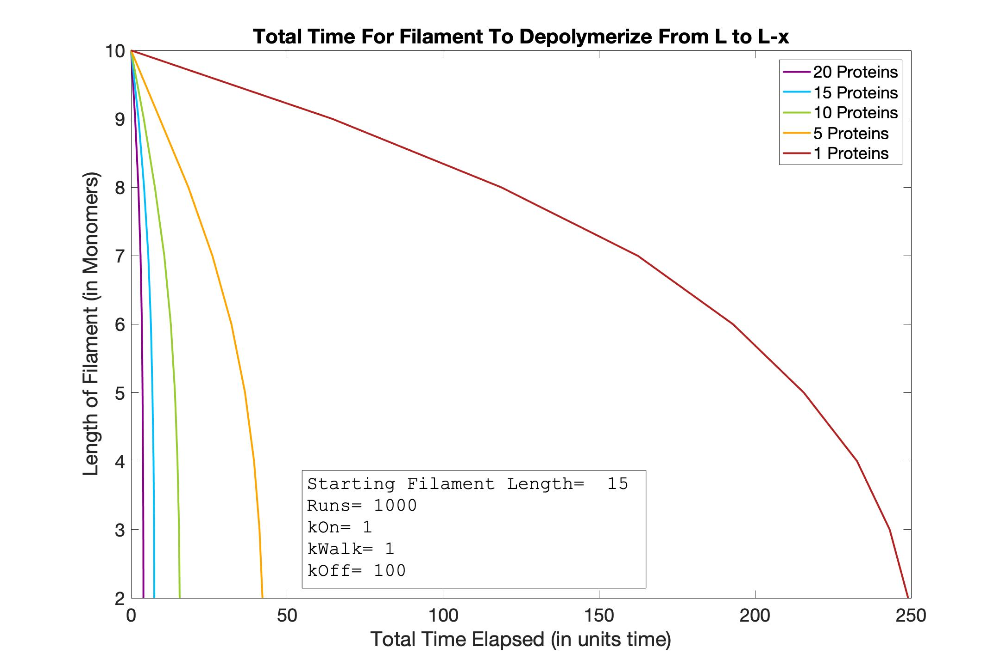
Time vs. Length
L=10

Slide 25
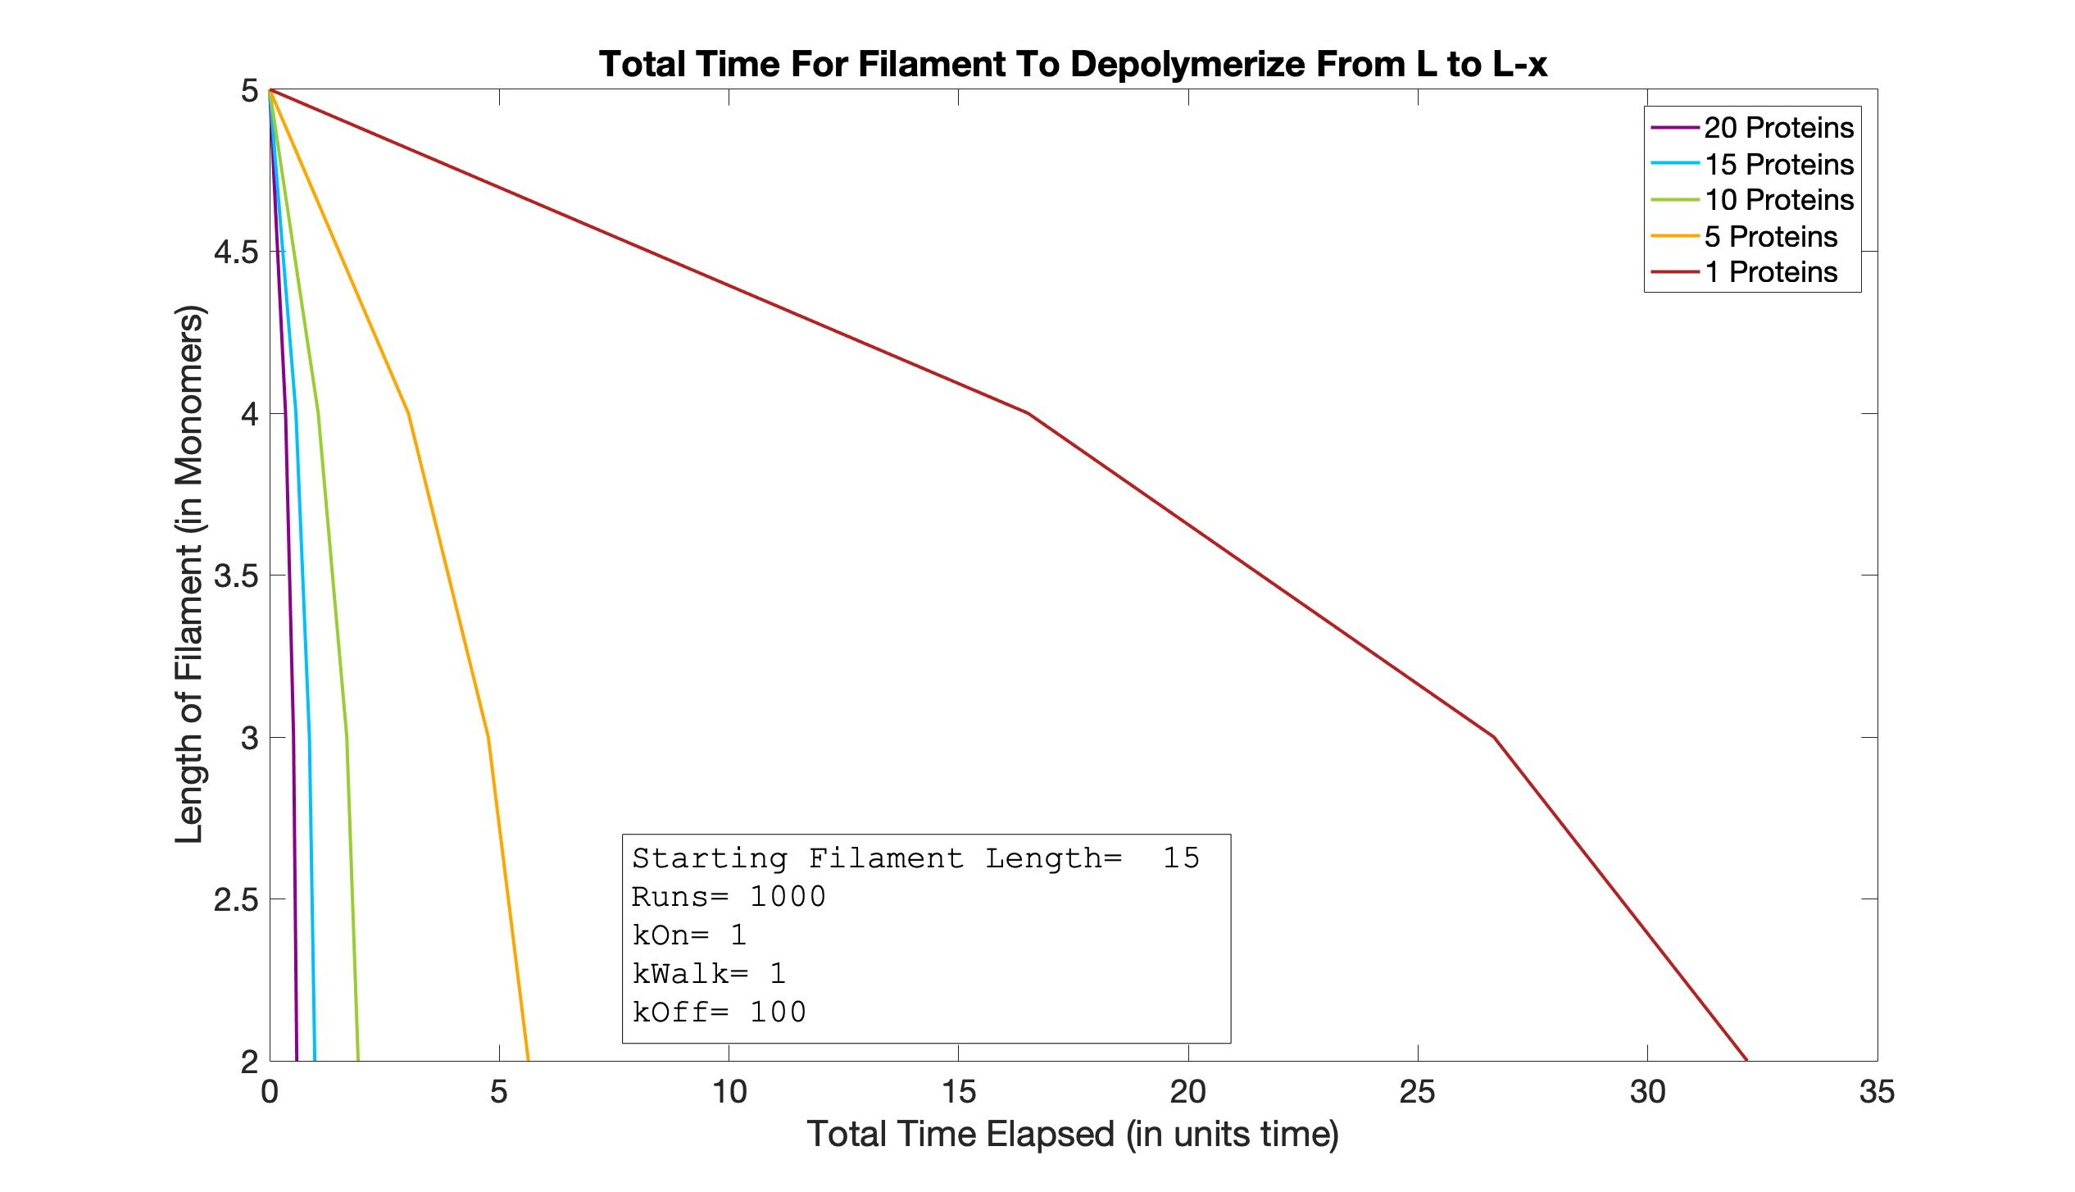
Time vs. Length
L=5

Slide 26
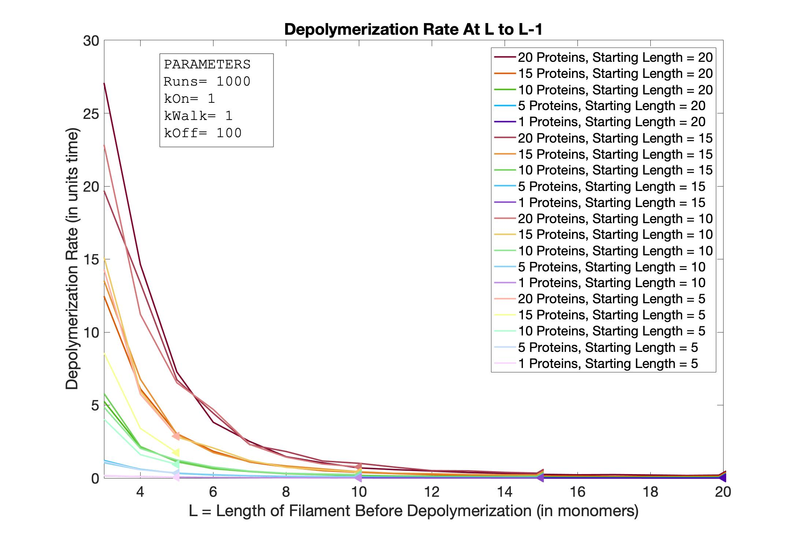
Length vs. Depol
All Lengths
All Protein Concentrations

Slide 27
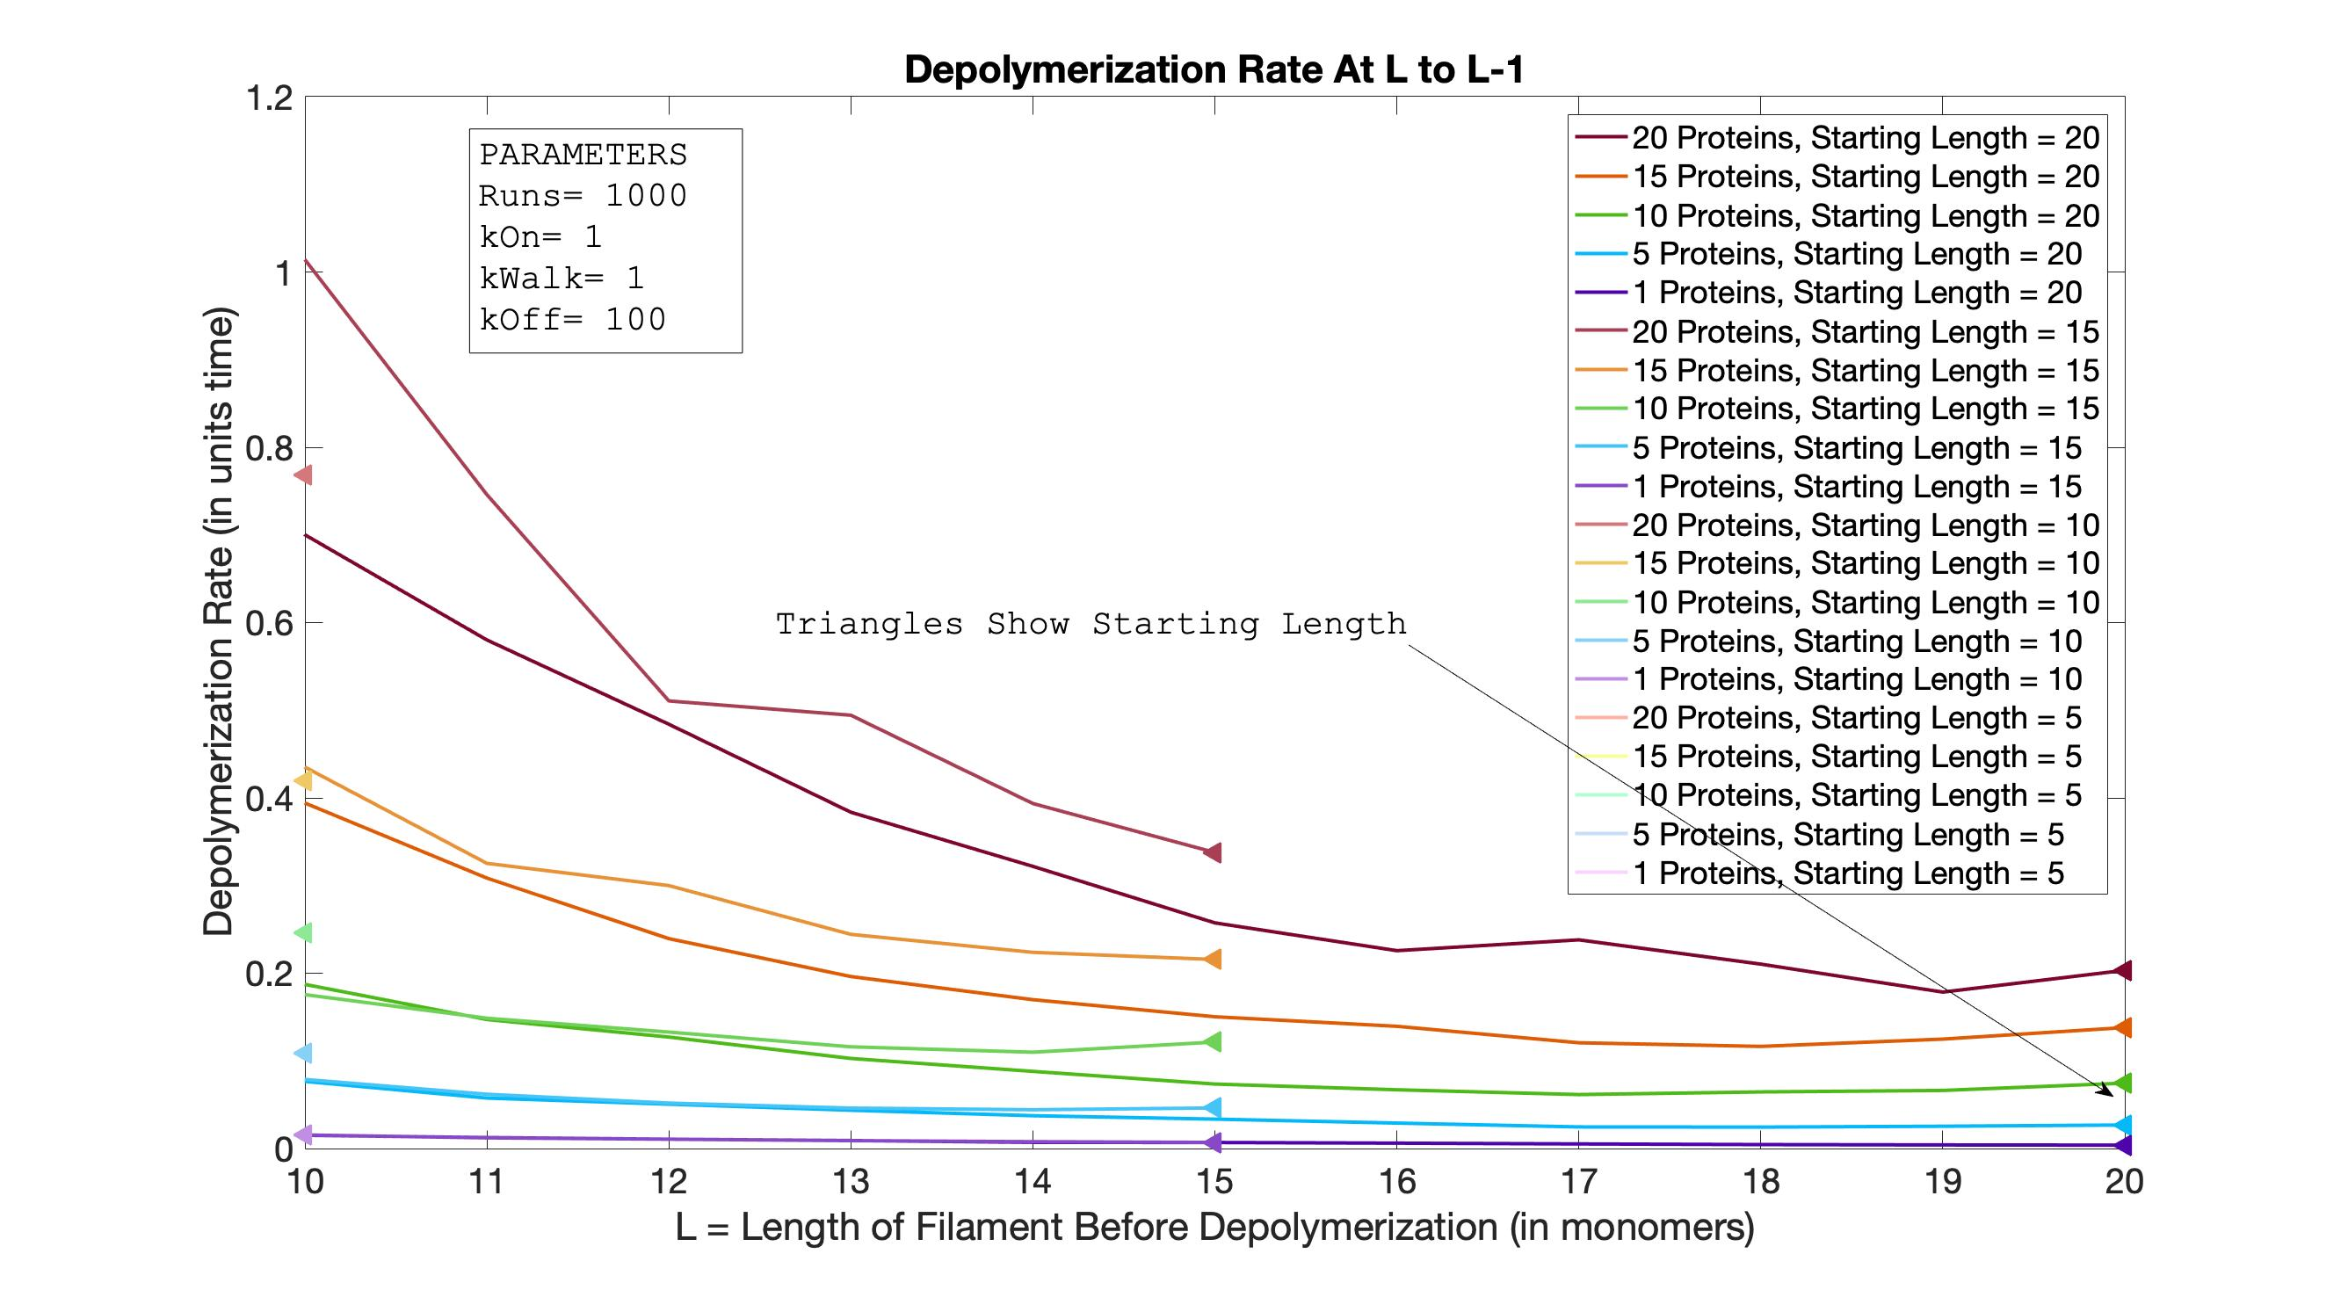
Length vs. Depol
All Lengths
All Protein Concentrations
ZOOM 1

Slide 28
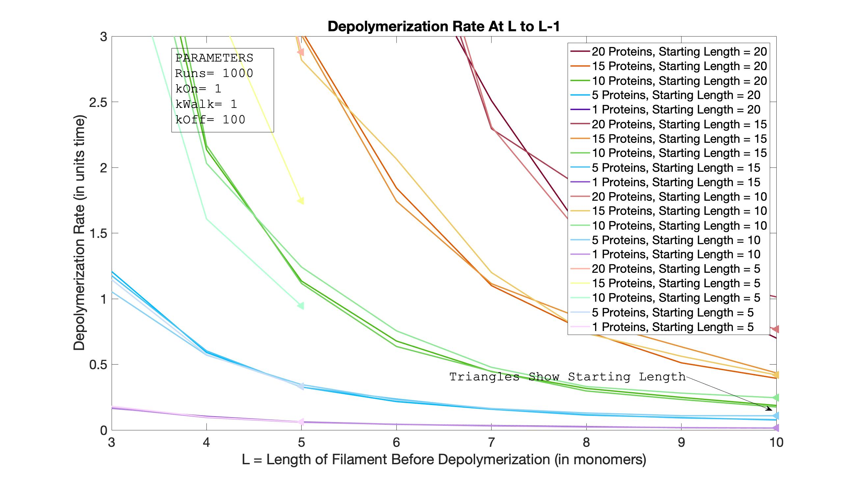
Length vs. Depol
All Lengths
All Protein Concentrations
ZOOM 2

Slide 29
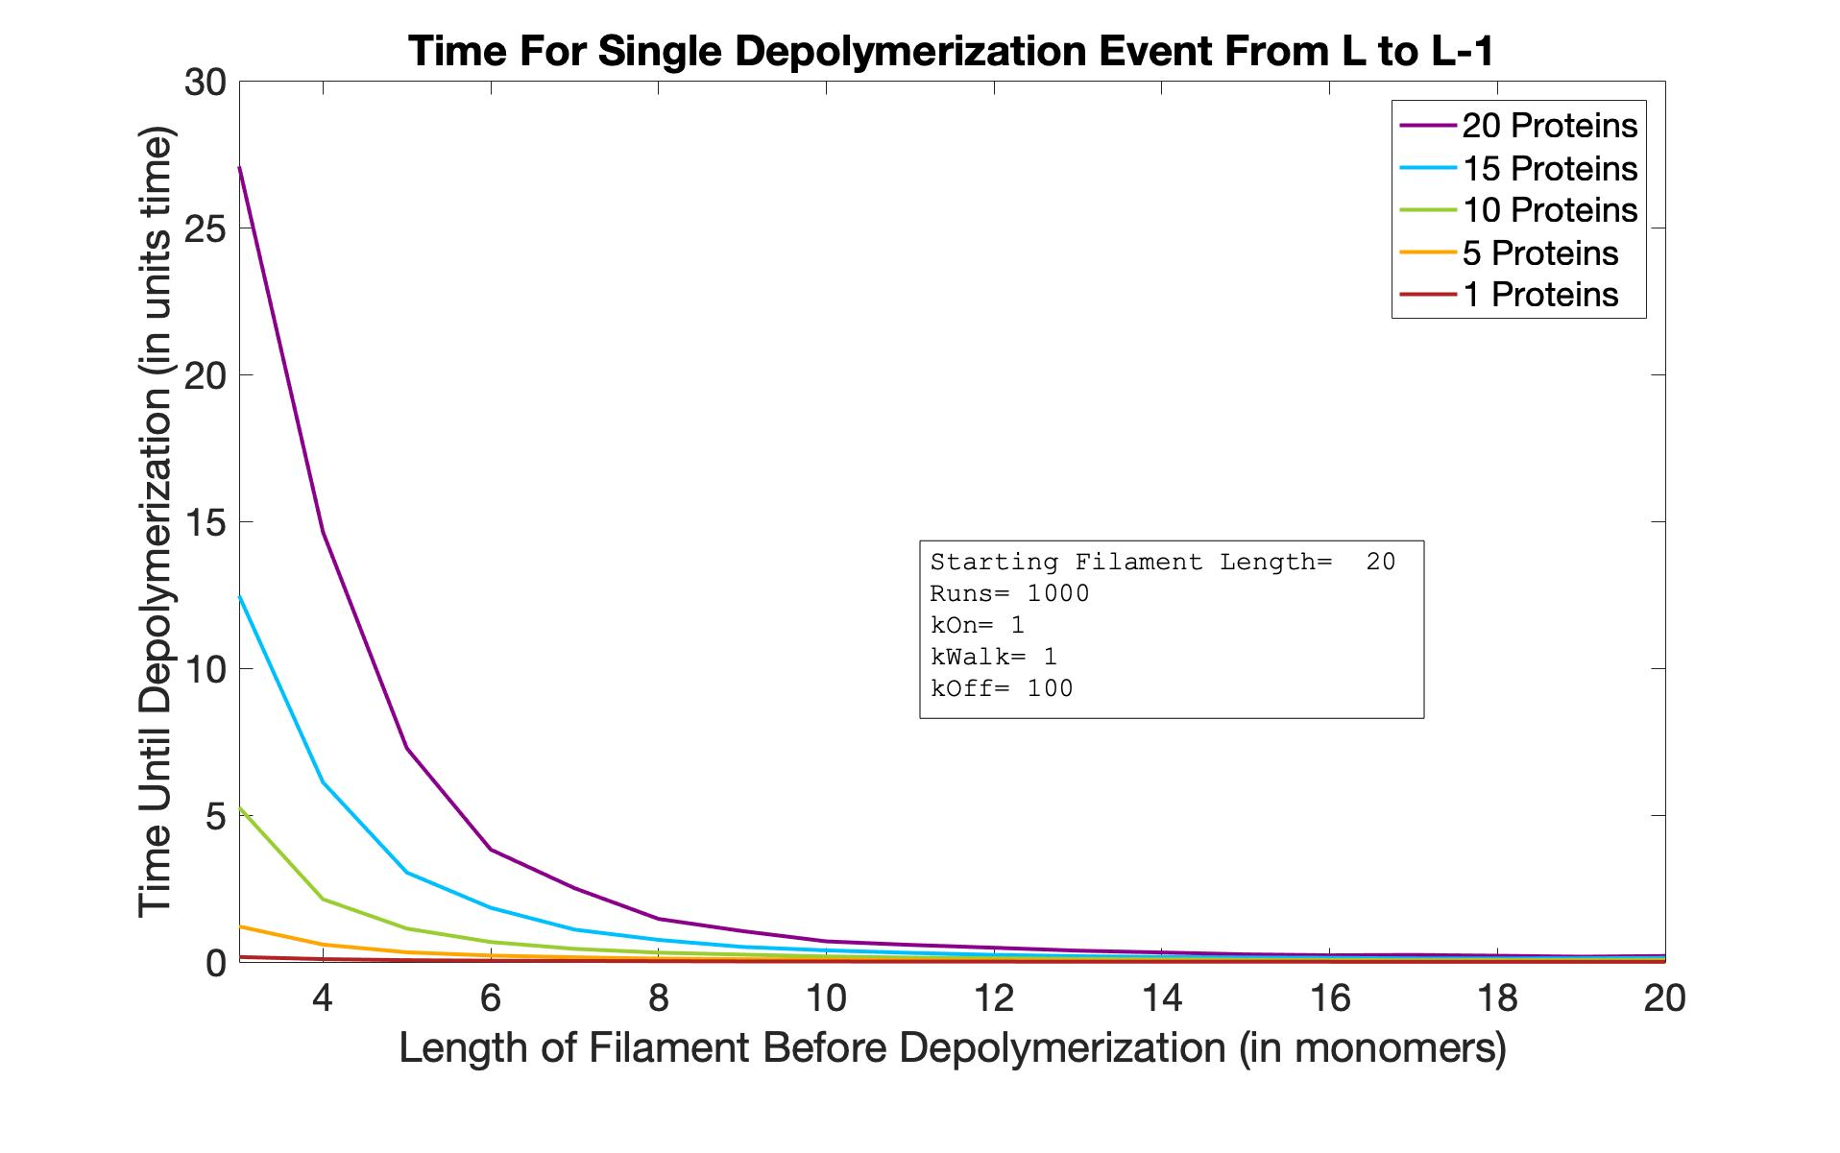
Length vs. Depol
L=20

Slide 30
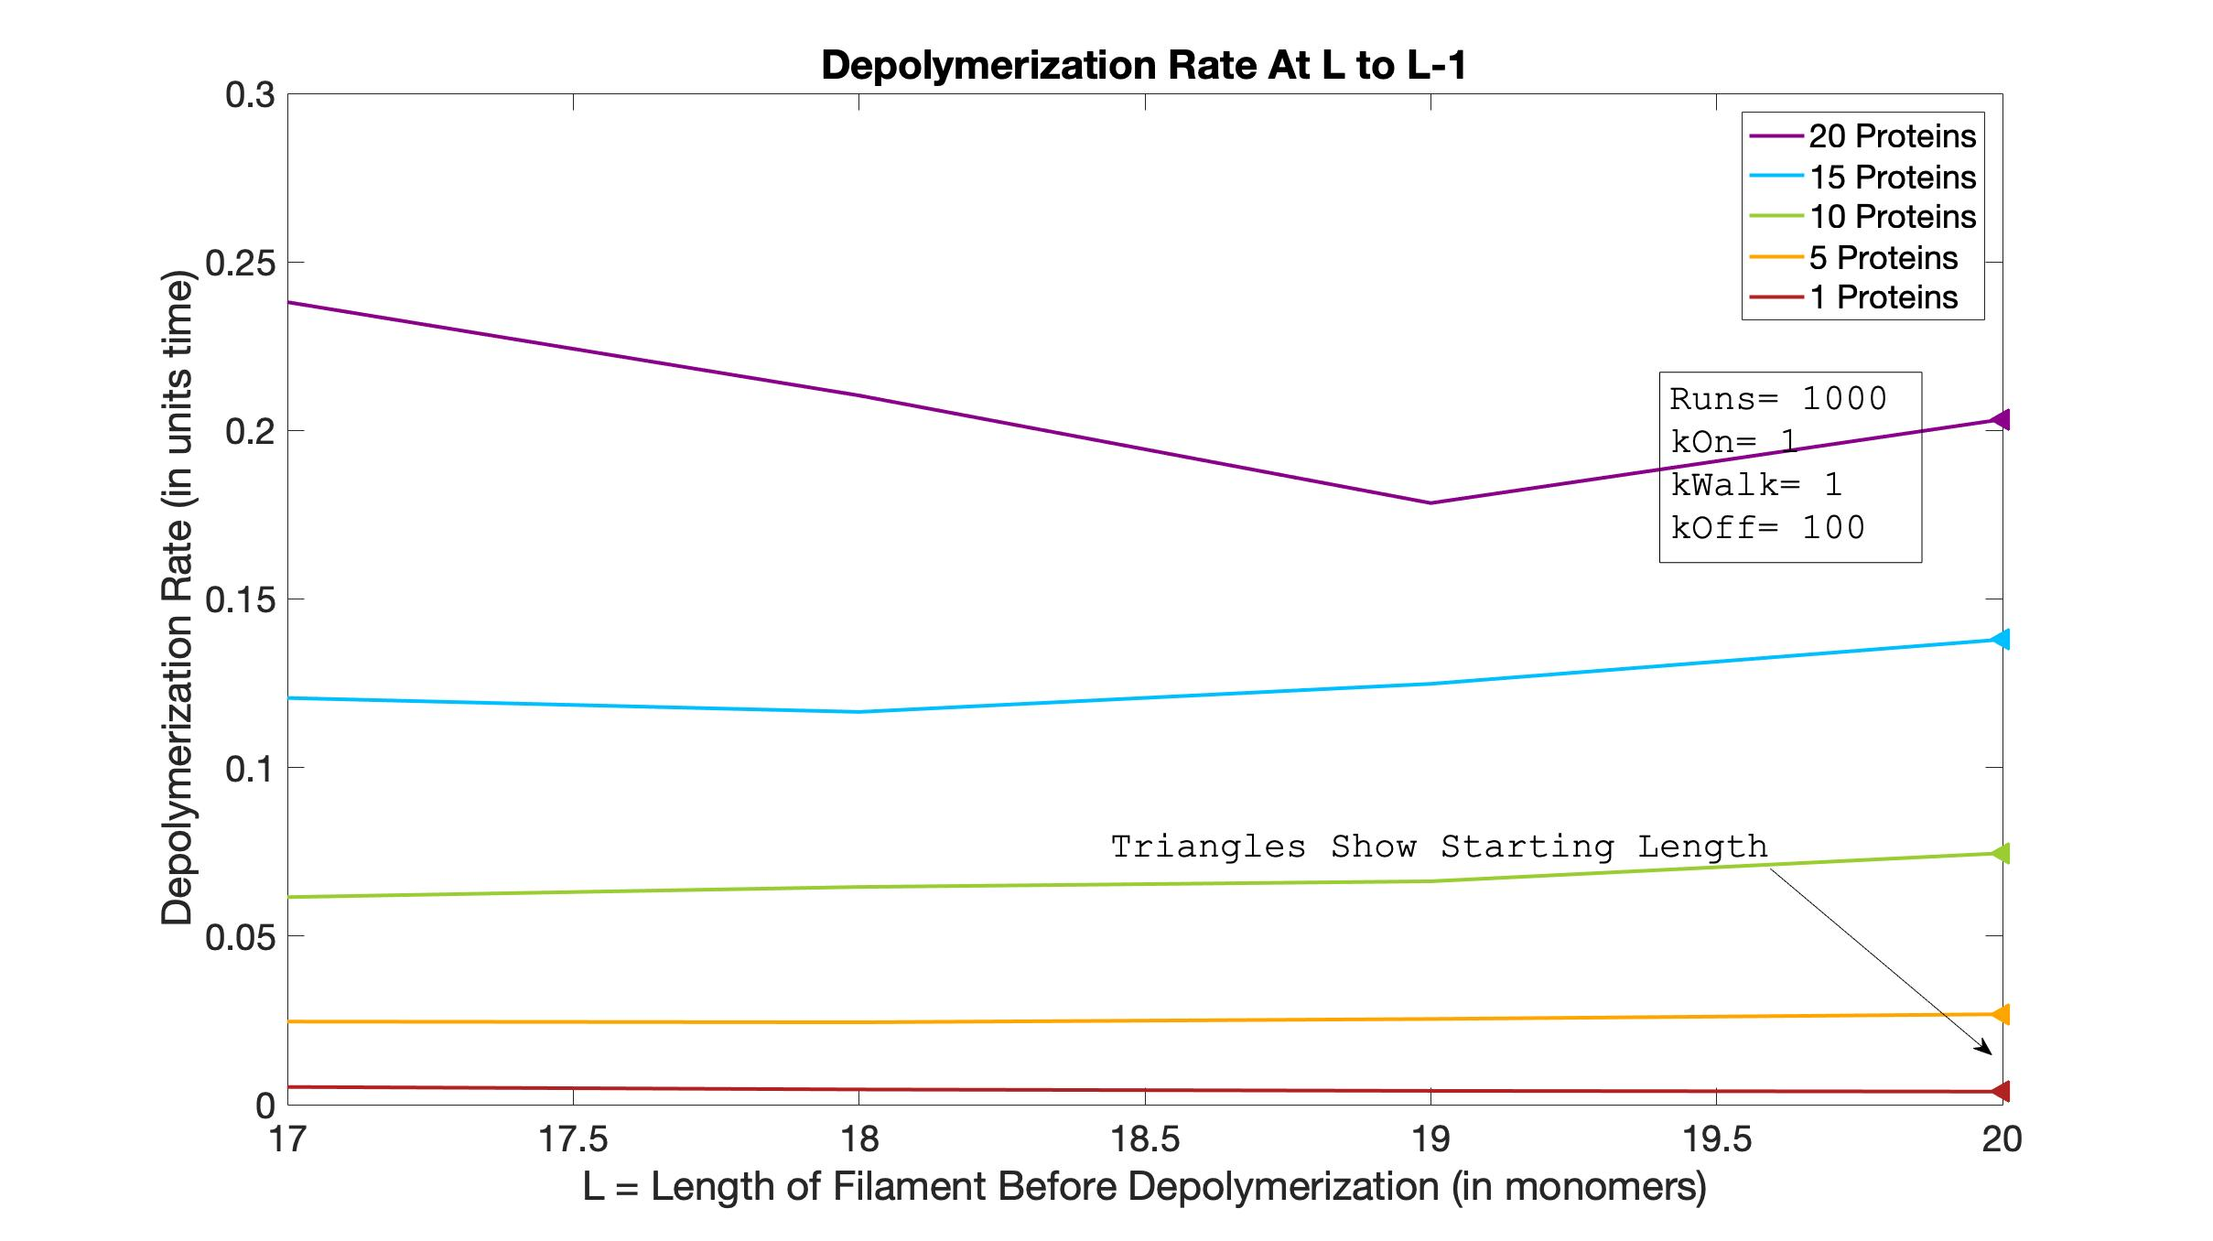
Length vs. Depol
L=20
ZOOM 1
Notes:
File actually called zoom 4

Slide 31
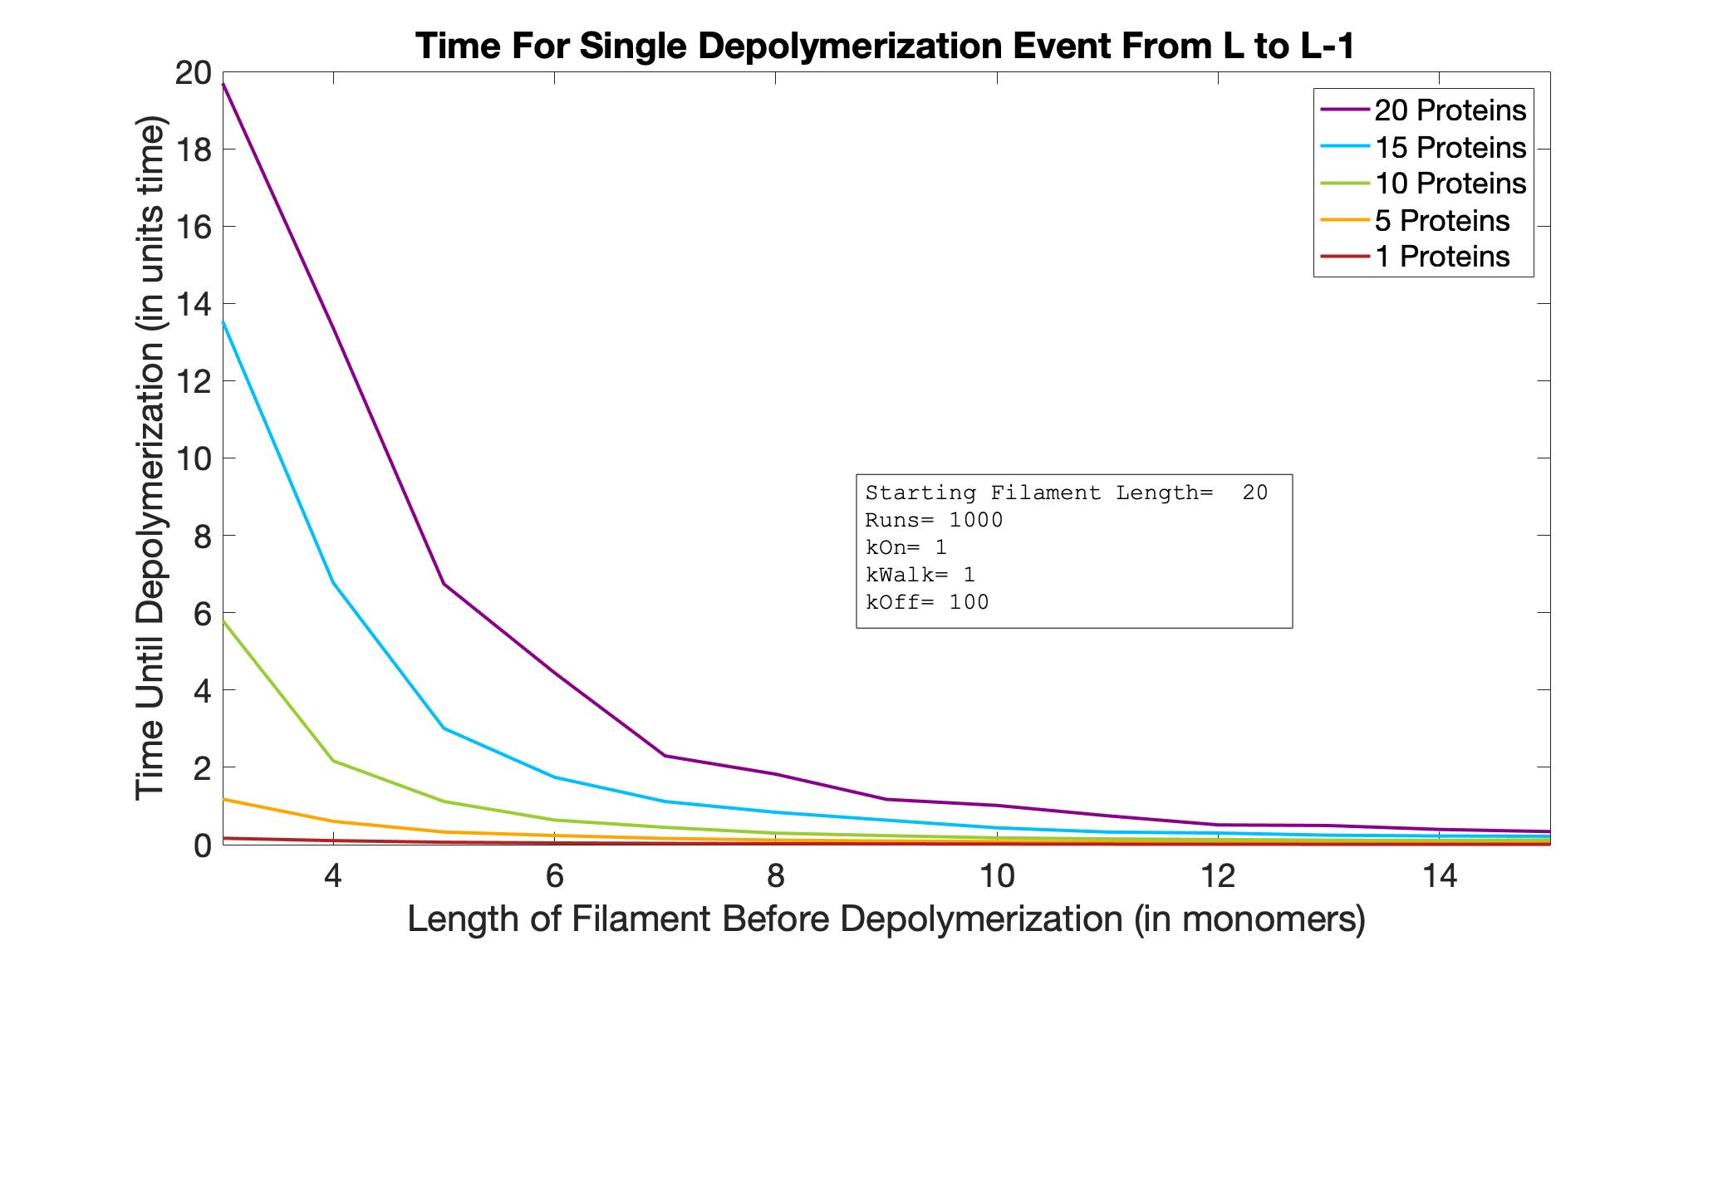
Length vs. Depol
L=15

Slide 32
Length vs. Depol
L=15
ZOOM 1

Slide 33
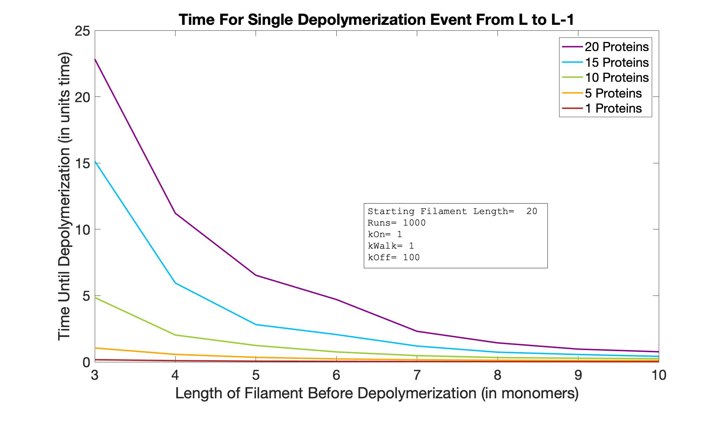
Length vs. Depol
L=10

Slide 34
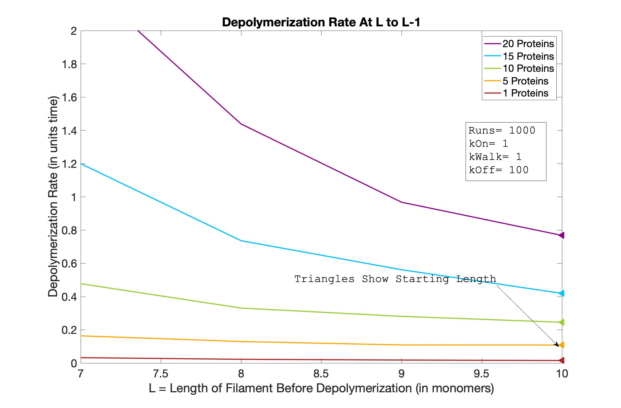
Length vs. Depol
L=10
ZOOM 1

Slide 35
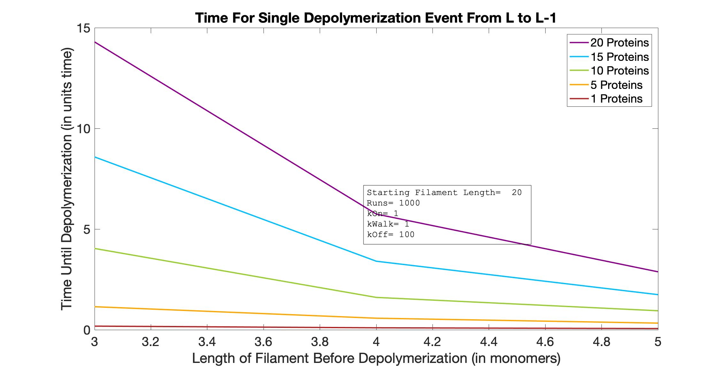
Length vs. Depol
L=5

Slide 36
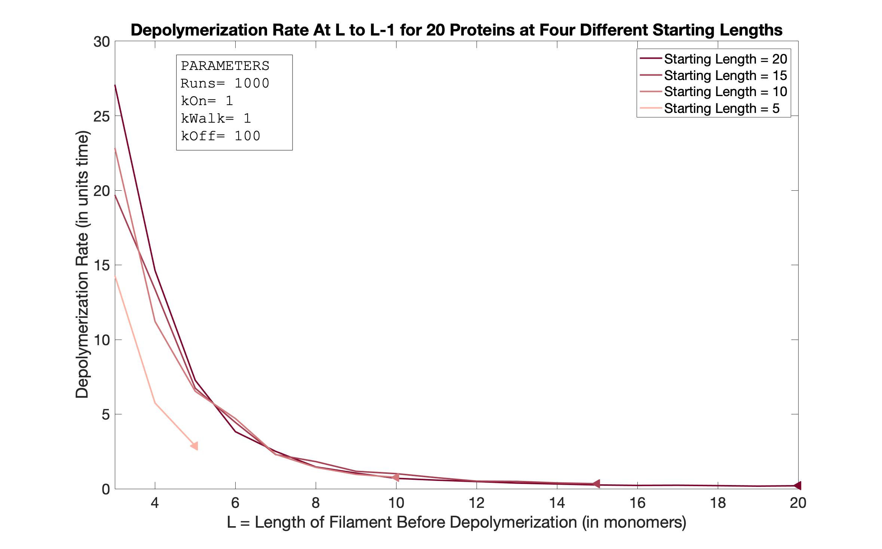
Length vs. Depol
P=20

Slide 37
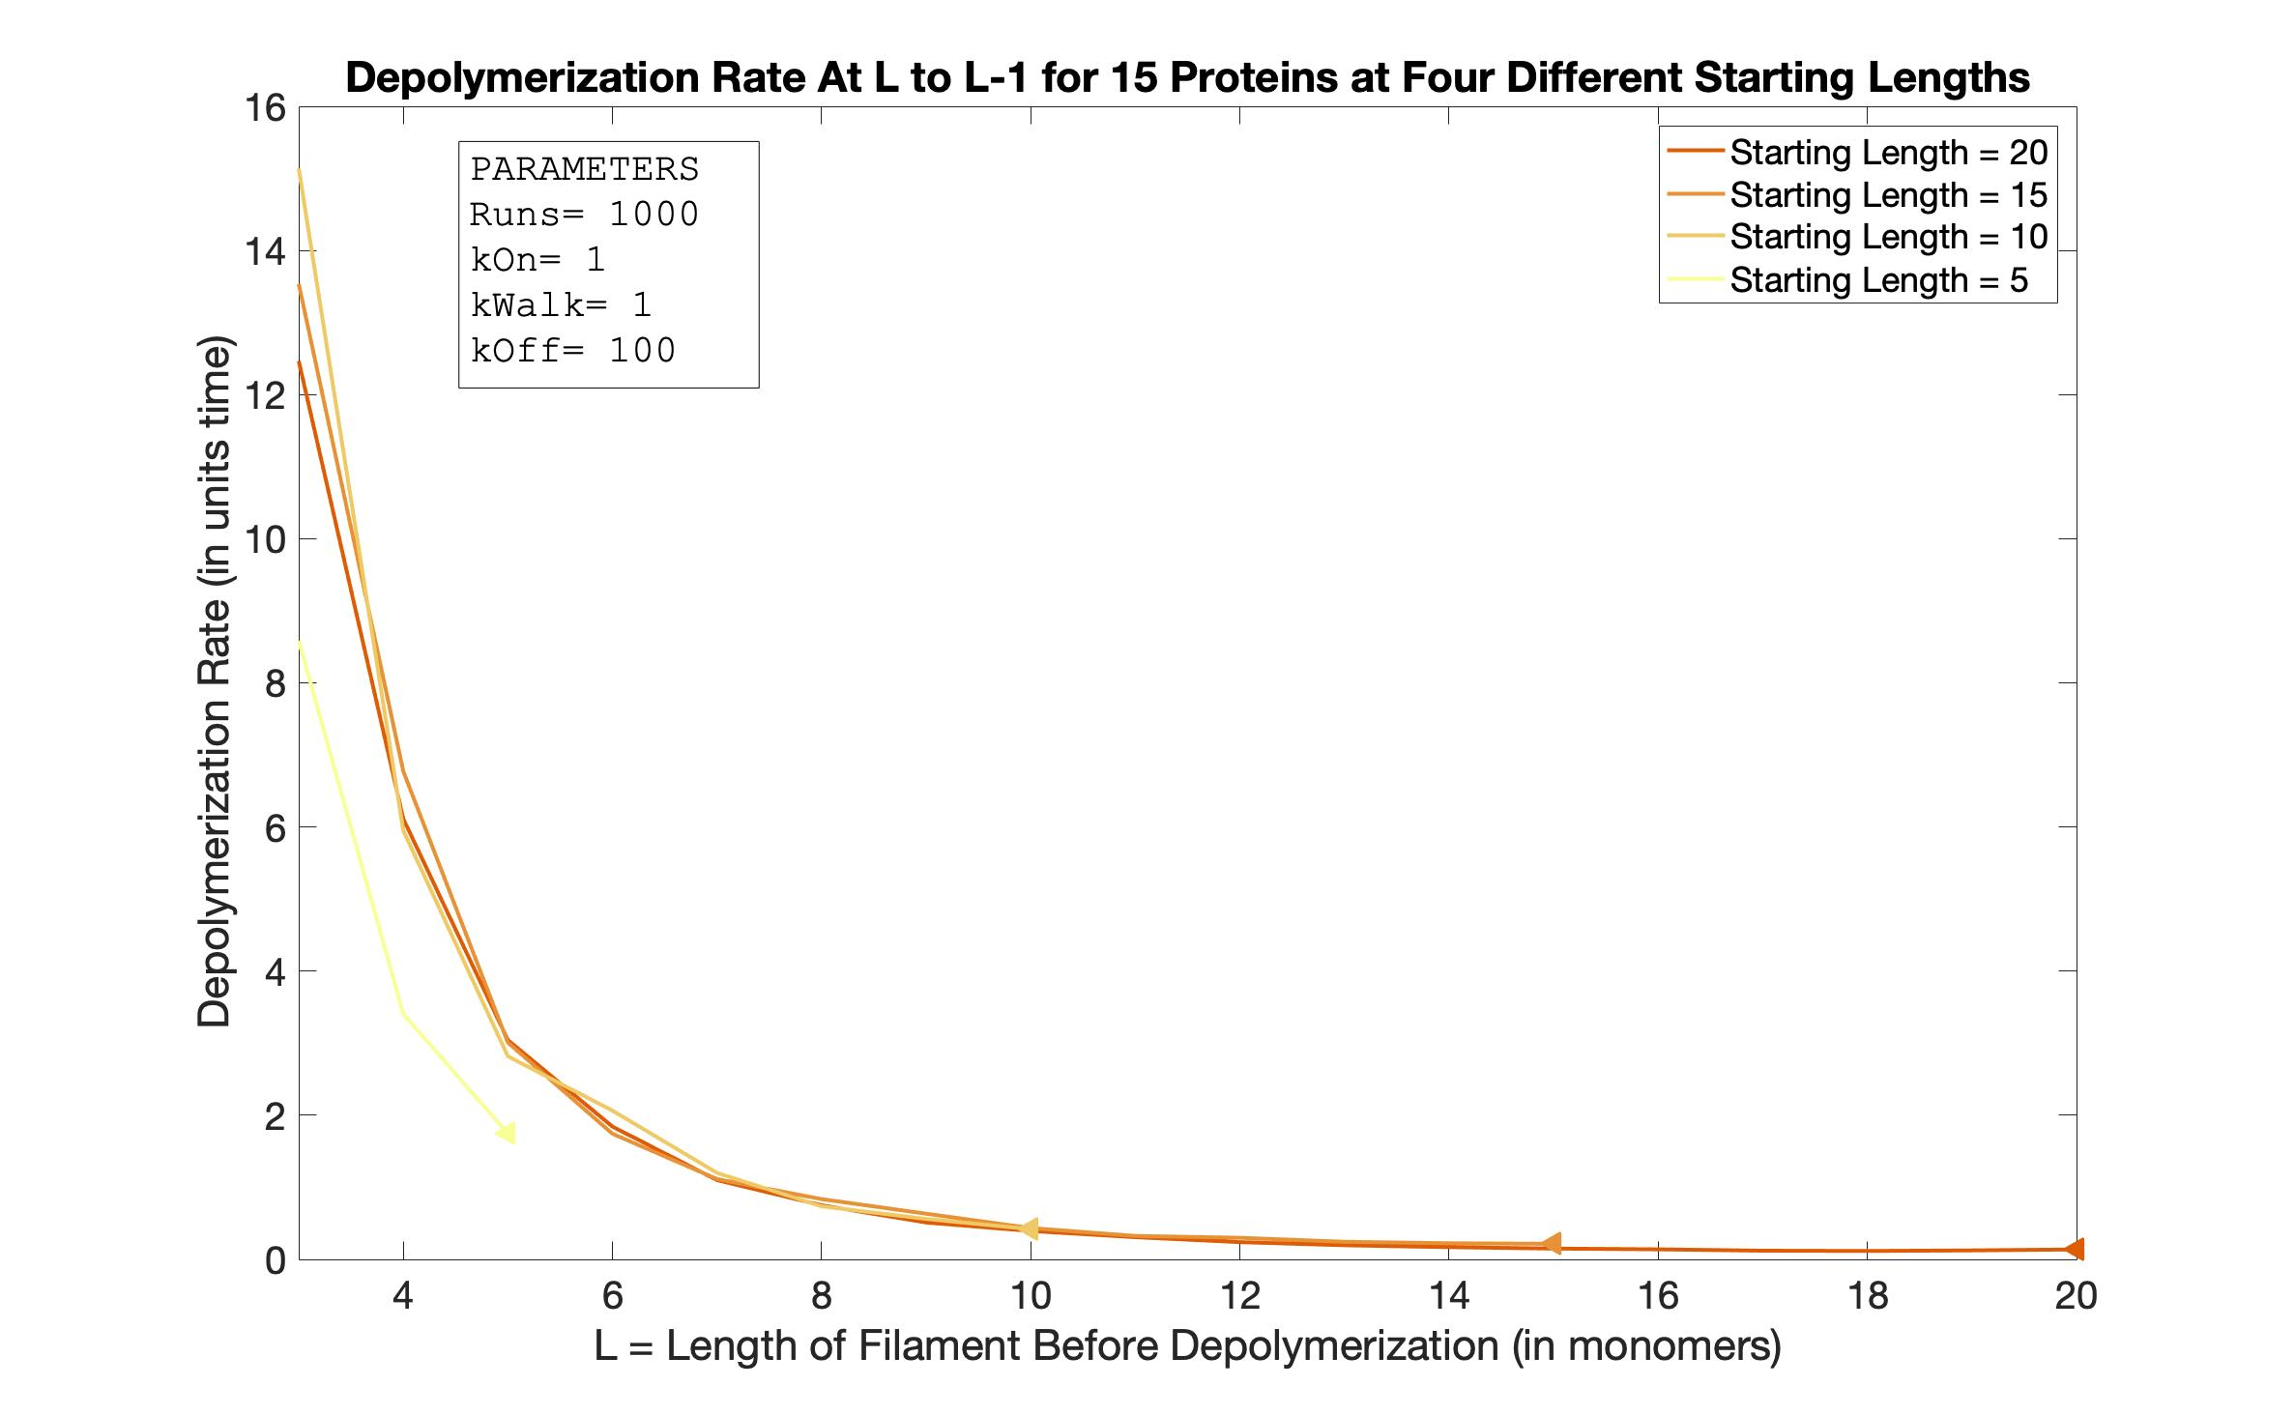
Length vs. Depol
P=15

Slide 38
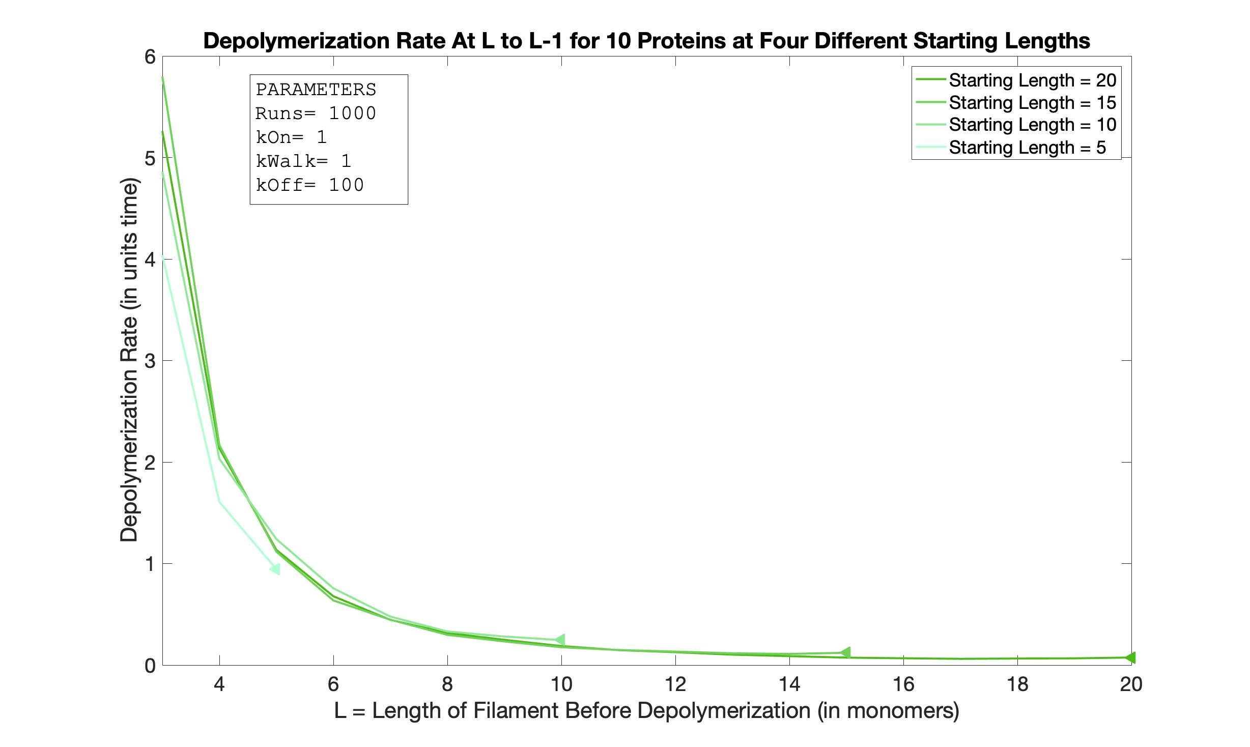
Length vs. Depol
P=10

Slide 39
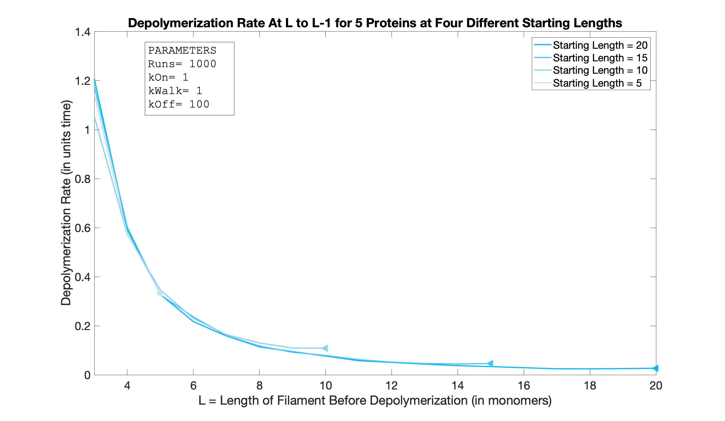
Length vs. Depol
P=5

Slide 40
20
Starting Length
Columns 1 through 8
0.0249 -0.0319 -0.0277 0.0123 -0.0317 -0.0645 -0.0617 -0.1004
0.0132 0.0083 -0.0041 -0.0188 -0.0109 -0.0195 -0.0264 -0.0432
0.0083 0.0017 0.0030 -0.0055 -0.0065 -0.0144 -0.0147 -0.0244
0.0014 0.0010 -0.0002 -0.0044 -0.0045 -0.0039 -0.0062 -0.0069
-0.0002 -0.0004 -0.0007 -0.0009 -0.0008 -0.0002 -0.0020 -0.0016
Columns 9 through 16
-0.0961 -0.1200 -0.3498 -0.4145 -1.0448 -1.3156 -3.4463 -7.3589
-0.0691 -0.0856 -0.1176 -0.2392 -0.3492 -0.7429 -1.2000 -3.0701
-0.0200 -0.0401 -0.0613 -0.0682 -0.1286 -0.2327 -0.4571 -0.9996
-0.0070 -0.0190 -0.0180 -0.0195 -0.0444 -0.0584 -0.1110 -0.2629
-0.0018 -0.0027 -0.0027 -0.0077 -0.0082 -0.0095 -0.0169 -0.0359
5
10
Proteins
15
20
15
Starting Length
Columns 1 through 8
-0.0558 -0.1007 -0.0163 -0.2353 -0.2681 -0.1575 -0.6510 -0.4726
-0.0081 -0.0205 -0.0556 -0.0254 -0.1098 -0.1986 -0.2025 -0.2785
0.0116 -0.0062 -0.0168 -0.0158 -0.0269 -0.0571 -0.0647 -0.1496
0.0020 -0.0019 -0.0057 -0.0101 -0.0169 -0.0133 -0.0253 -0.0431
-0.0008 -0.0012 -0.0017 -0.0015 -0.0033 -0.0031 -0.0060 -0.0071
Columns 9 through 11
-2.1507 -2.2963 -6.6200
-0.6284 -1.2654 -3.7645
-0.1894 -0.4802 -1.0504
-0.0755 -0.0909 -0.2758
-0.0119 -0.0179 -0.0425
5
Stable!
Proteins
10
15
Rate
Disassembly
20
Assembly
γ(L)
10
Starting Length
r(L)
5
-0.1997 -0.4706 -0.8722 -2.3961 -1.8291 -4.6775
-0.1423 -0.1745 -0.4635 -0.8644 -0.7537 -3.1335
-0.0354 -0.0499 -0.1466 -0.2780 -0.4857 -0.7900
-0.0005 -0.0207 -0.0341 -0.0657 -0.1167 -0.2248
-0.0030 -0.0044 -0.0099 -0.0113 -0.0146 -0.0368
10
Proteins
L*
Length
15
20
5
Starting Length
Slope of Length vs. Depol
REMEMBER: If we want size control, the disassembly rate must grow with length!
5
-2.8678 -8.5487
-1.6598 -5.1785
-0.6627 -2.4300
-0.2437 -0.5710
-0.0380 -0.0826
10
Proteins
Positive slopes highlighted in magenta
15
20

Slide 41
Analysis
Only places where slope is positive are at the very beginning of Starting Length=20 and Starting Length=15 graph
These simulations were only run 1000 times, so there could be inaccuracies
This is likely when the filament is “filling up” with proteins
This mechanism likely isn’t useful for controlling length in the long term, but could be useful when a filament is depleted of proteins for some reason
Curious to see what happens in a model where proteins “disappear” from the simulation after they take off a monomer
Curious if a two sided model might add to this effect (“bunching up” effect may be greater for long filaments, so adding two sided may make things relatively faster compared to length)

Slide 42
6/17/20 Meeting Notes
Try 2 sided vs. 1 sided
Biasing starting position (what if protein can only land in 2nd half of filament)
Landing only on the end
Changing when proteins are able to re-bind
Proteins become free (equal prob landing anywhere)
Gradient (Higher probability of landing toward end after falling off once)
Proteins cannot re-bind (0 probability of landing)
What we have now
3 General Cases

Slide 43
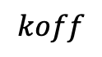













$$Ktotal =Kon+Koff+Kwalk$$
$$Ktotal=$$
$$DT=$$
$$When:$$
No proteins on filament
$$\frac{1}{kon∗L∗P }$$
$$kon∗L∗FP$$
$$=kon∗L∗P$$
Proteins on filament & free proteins
$$\frac{1}{(kon∗L∗FP)+(kwalk∗BP) }$$
$$(kon∗L∗FP)+(kwalk∗BP)$$
All proteins on filament
$$\frac{1}{kwalk∗P }$$
$$(kwalk∗BP)$$
$$=kwalk∗P$$
Any protein on end
$$koff$$
$$\frac{1}{koff}$$

Slide 44





The amount of time in a simulation depends on how much time a protein spends landing, walking, and falling off
First, most steps of the simulation will involve a protein landing. How long an on step takes (DT) depends on the Length and the number of bound proteins (BP), and how many steps the simulation spends landing depends on how many total proteins (P) and monomers (L) there are.
As BP increases, so does the likelihood of walking. The fewer free proteins, the less dependent the step time (DT) is on length. Once FP=0, DT=$\frac{1}{kwalk∗P }$, proteins can only walk (until one reaches the end). If L >> P, there will be lots of room to walk, otherwise, few will have the chance to walk.
Once the number of bound proteins (BP) = length (L), the simulation will rapidly depolymerize (this depol rate is the same regardless of P or L because it only depends on k’off)
→ This is likely why the P=20, SL=5 LVD line is so off of the other P=20 lines: Landing steps take a very long time comparatively because of small L, then there isn’t time to “make up for it” by spending very little time walking or falling off once the filament is filled up (once it fills up, simulation is almost over)
Over time, bound proteins grow while free proteins shrink. Box 1 & 3 are the extremes.
Eventually, if L>>P proteins will mostly be walking (this extreme not reached when P>L)
When all the proteins are lined up, they mostly fall off
This is the first step of every run of the simulation
$$\frac{1}{kon∗L∗P }$$
$$\frac{1}{(kon∗L∗FP)+(kwalk∗BP) }$$
$$\frac{1}{kwalk∗P }$$
$$\frac{1}{koff}$$
0
Bound Proteins (BP) ↑
P
P
Free Proteins (FP) ↓
0

Slide 45



























$$DT=\frac{1}{Small∗Small}=Very Large$$
$$DT=\frac{1}{Small}=Large$$
$$DT=Rapid Fall Off$$
Spends few steps landing with very large DT, some time walking with large DT, then few steps falling off
P=Small
SL=Small
Landing
Walking
Falling Off
$$Spends few steps here$$
$$Spends some time here$$
$$Spends few steps here$$
$$DT=\frac{1}{Large∗Large }=Very Small$$
$$DT=\frac{1}{Large}=Small$$
$$DT=Rapid Fall Off$$
Spends many steps landing with very small DT, some time walking with small DT, then many steps falling off
P=Large
SL=Large
Landing
Walking
Falling Off
$$Spends many steps here$$
$$Spends some time here$$
$$Spends many steps here$$
$$DT=\frac{1}{Large∗Small }=Small$$
$$DT=\frac{1}{Small}=Large$$
$$DT=Rapid Fall Off$$
Spends few steps landing with small DT, many steps walking with large DT, then many steps falling off
P=Small
SL=Large
Landing
Walking
Falling Off
$$Spends few steps here$$
$$Spends many steps here$$
$$Spends many steps here$$
P=Large
SL=Small
$$DT=\frac{1}{Small∗Large }=Small$$
$$DT=\frac{1}{Large}=Small$$
$$DT=Rapid Fall Off$$
Spends few steps landing with small DT, almost no steps walking with small DT, then few steps falling off
Landing
Walking
Falling Off
$$Spends few steps here$$
$$Spends almost no steps here$$
$$Spends few steps here$$
$$\frac{1}{kon∗L∗P }$$
$$\frac{1}{(kon∗L∗FP)+(kwalk∗BP) }$$
$$\frac{1}{kwalk∗P }$$
$$\frac{1}{koff}$$
0
Bound Proteins (BP) ↑
P
P
Free Proteins (FP) ↓
0

Slide 46

Set L=[50], P=[50 20 10 5 1]
Time vs. Length
L=50

Slide 47

Set L=[50], P=[50 20 10 5 1]
Length Vs. Depol
L=50

Slide 48

Set L=[50], P=[50 20 10 5 1]
Length Vs. Depol
L=50
ZOOM 1

Slide 49

Set L=[50], P=[50 20 10 5 1]
Length Vs. Depol
L=50
ZOOM 2

Slide 50

Set L=[50], P=[50 20 10 5 1]
Length Vs. Depol
L=50
ZOOM 3

Slide 51
50
Columns 1 through 12
0.0199 0.0155 0.0022 -0.0107 0.0101 -0.0002 -0.0120 0.0050 0.0040 0.0015 -0.0058 -0.0087
0.0100 0.0070 0.0027 -0.0011 0.0021 0.0003 -0.0010 -0.0001 -0.0007 -0.0008 0.0001 -0.0019
0.0039 0.0013 0.0005 0.0004 0.0001 -0.0005 -0.0005 -0.0001 -0.0006 -0.0005 0.0001 -0.0001
0.0010 0.0003 0.0001 -0.0001 -0.0004 -0.0002 0.0002 -0.0004 -0.0006 0.0002 -0.0002 -0.0004
-0.0000 -0.0000 -0.0001 0.0000 -0.0001 -0.0000 0.0000 -0.0001 -0.0000 -0.0001 0.0001 -0.0001
Slope of Length vs. Depol
5
10
Proteins
15
20
Columns 13 through 24
-0.0061 -0.0156 -0.0184 0.0157 -0.0283 0.0097 -0.0413 -0.0079 -0.0187 -0.0377 -0.0412 -0.0575
-0.0009 -0.0023 -0.0004 -0.0001 -0.0012 -0.0044 -0.0025 -0.0010 -0.0041 -0.0012 -0.0063 -0.0021
-0.0010 -0.0004 -0.0008 -0.0008 -0.0012 -0.0010 -0.0008 -0.0017 -0.0018 0.0004 -0.0018 -0.0025
-0.0002 0.0000 -0.0008 -0.0003 -0.0002 -0.0010 0.0002 -0.0006 -0.0006 -0.0005 -0.0012 -0.0001
-0.0002 0.0000 -0.0001 0.0000 -0.0000 -0.0002 -0.0001 -0.0001 -0.0001 -0.0001 -0.0003 0.0000
Stable!
Rate
Disassembly
Assembly
γ(L)
Columns 25 through 36
-0.0263 -0.0827 -0.0265 -0.1194 -0.1186 -0.3872 -0.4093 -0.1612 -0.1411 -0.4793 -0.3409 -2.1233
-0.0020 -0.0071 -0.0061 -0.0062 -0.0098 -0.0209 -0.0043 -0.0213 -0.0176 -0.0265 -0.0207 -0.0581
-0.0007 -0.0021 -0.0016 -0.0054 -0.0014 -0.0066 -0.0027 -0.0069 -0.0051 -0.0057 -0.0071 -0.0105
-0.0010 -0.0007 -0.0017 -0.0004 -0.0033 -0.0010 0.0002 -0.0049 -0.0008 -0.0031 -0.0045 -0.0062
-0.0004 -0.0003 -0.0001 -0.0003 -0.0003 -0.0006 -0.0002 -0.0004 -0.0009 -0.0004 -0.0011 -0.0011
r(L)
L*
Length
Columns 37 through 47
-1.3566 -1.2735 -4.2534 -1.7878 -4.8568 -7.3106 -16.2676 -7.7128 -17.8863 -11.4744 -10.9804
-0.0601 -0.0456 -0.1125 -0.1946 -0.3703 -0.3698 -1.1212 -1.1575 -3.2902 -8.3296 -17.9189
-0.0138 -0.0205 -0.0253 -0.0317 -0.0749 -0.1036 -0.1294 -0.1811 -0.6001 -0.8335 -3.7130
-0.0065 -0.0086 -0.0093 -0.0093 -0.0214 -0.0256 -0.0437 -0.0545 -0.1431 -0.2147 -0.5256
-0.0005 -0.0023 -0.0017 -0.0024 -0.0041 -0.0071 -0.0057 -0.0093 -0.0262 -0.0308 -0.0730
REMEMBER: If we want size control, the disassembly rate must grow with length!
Positive slopes highlighted in magenta

Slide 52
What if Proteins Could Only Land On The End?
The following figures show the multiple protein simulation when proteins can only land on the final monomer of the filament.

Slide 53

Time vs. Length (END BINDING)
All Lengths
All Protein Concentrations

Slide 54

Time vs. Length (END BINDING)
All Lengths
All Protein Concentrations
ZOOM 1

Slide 55

Time vs. Length (END BINDING)
All Lengths
All Protein Concentrations
ZOOM 2

Slide 56

Length Vs. Depol (END BINDING)
All Lengths
All Protein Concentrations

Slide 57
6/23/20 Meeting (Jane, Lishi, Lena)
Follow up with Shashank’s research
Distributions
1D Diffusion is only helpful when 3D Diffusion Time>>1D Diffusion Time
Consider adding a rate at which proteins fall off naturally (not at the end)
Look at what happens when the number of free proteins stays constant
Jane says this is more applicable to physical scenarios– but wouldn’t this only be true when the concentration is very high
In reality, the concentration is likely very high, but it seems like our tests for low concentrations wouldn’t be accurate
Length control seems like it’s only possible at low concentrations when the filament starts empty

Slide 58
Scenarios To Consider
Other things to consider:
One vs. two sided
Whether bound proteins deplete free proteins
Whether proteins re-join pool after depolymerizing
Are they more likely to re-bind at the end? (Gradient)
Could a gradient help length control?
Proteins falling off without reaching the end
Whether proteins can occupy/ land on the same filament
Whether making kOff less likely (multiple proteins can be on end, being on end doesn’t guarantee depolymerization, making k’off smaller, etc.)

Slide 59
What to Do Next?
Make visual graph of protein positions on shrinking filament
Look at situations where Starting Length >> Concentration
Choose what direction to go in (see previous slide)

Slide 60

6/24/20 Meeting (Lishi, Lena)
Talk about yesterday’s meeting/ best ways to be prepared & make slides
Discuss/summarize what we covered yesterday
Talk about new focus/direction
Next steps/To-Do List
Make version of current simulation where conc(free motors) is consistent
Kon does not depend on number of free proteins $kOn=k^{′}on∗\left(Number of monomers\right)$
Plot length vs. time graph with number of motors (same length, different number of proteins), plot disassembly rate vs length. Do the same for keeping number of proteins the same and changing the length
Have a kOff where you can fall off anywhere / not guaranteed to fall off once it reaches end
Visual length/time/position of motors
Do two sided version of code

Slide 61

Total Time vs. Length
Consistent FP Conc.
L=20
P=5

Slide 62

Depol Rate vs. Length
Consistent FP Conc.
L=20
P=3

Slide 63

Total Time vs. Length
Consistent FP Conc.
L=20
P=3

Slide 64

Depol Rate vs. Length
Consistent FP Conc.
L=20
P=5

Slide 65
Total Time vs. Length
Consistent FP Conc.
L=20
P=3

Slide 66
Depol Rate vs. Length
Consistent FP Conc.
L=20
P=3

Slide 67

Total Time vs. Length
Consistent FP Conc.
L=15
P=2

Slide 68

Depol Rate vs. Length
Consistent FP Conc.
L=15
P=2

Slide 69

Total Time vs. Length
Consistent FP Conc.
L=15
P=5

Slide 70

Depol Rate vs. Length
Consistent FP Conc.
L=15
P=5

Slide 71
Free Proteins Decrease As Bound Proteins Increase
Free Proteins Constant As Bound Proteins Increase
Comparison
Decreasing vs. Constant Free Proteins
P=2
L=15

Slide 72

Time vs. Length (CONSTANT FP)
All Lengths
All Protein Concentrations

Slide 73

Time vs. Length (CONSTANT FP)
All Lengths
All Protein Concentrations
ZOOM 1

Slide 74

Length Vs. Depol (CONSTANT FP)
All Lengths
All Protein Concentrations

Slide 75

Length Vs. Depol (END BINDING)
P=20

Slide 76

Length Vs. Depol (END BINDING)
P=15

Slide 77

Length Vs. Depol (END BINDING)
P=10

Slide 78

Length Vs. Depol (END BINDING)
P=5

